Slide 1
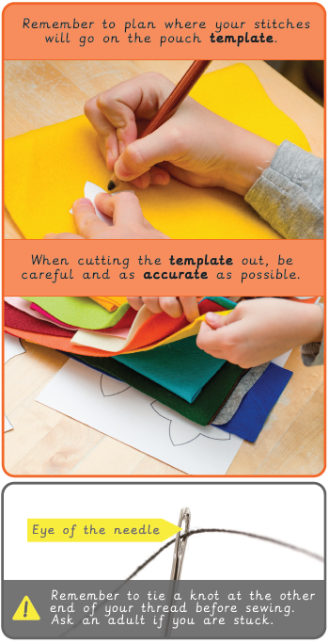
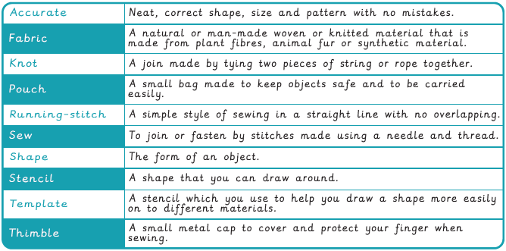
Vocabulary
Year 2 Textiles – Pouches
Key Facts

Slide 2
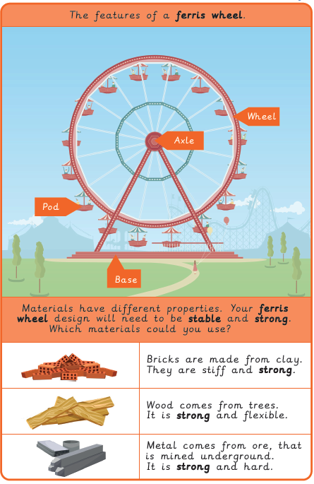
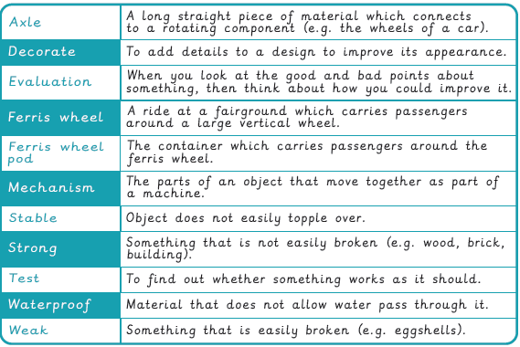
Vocabulary
Year 2 Mechanical Systems - Fairground wheel
Key Facts
Did you know?

Slide 3
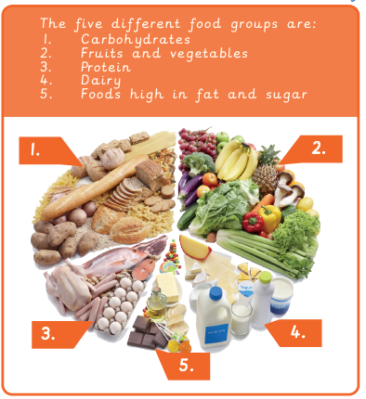
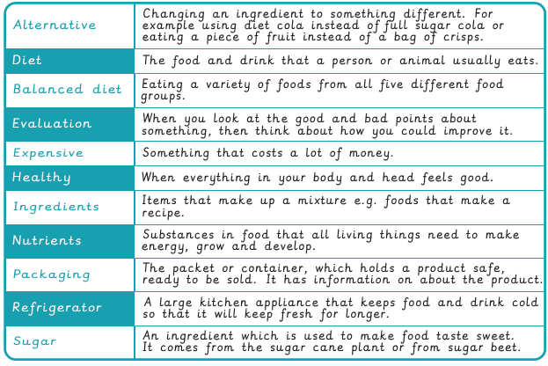
Vocabulary
Year 2 Food – A balanced diet
Key Facts
Key Facts

