Slide 1
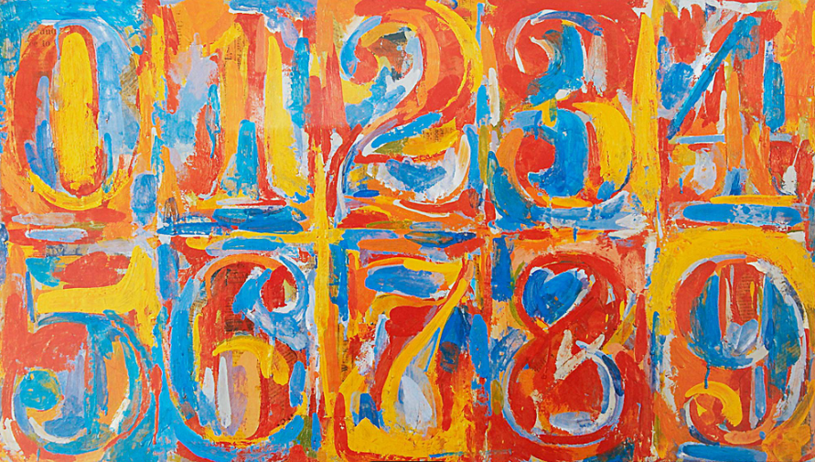
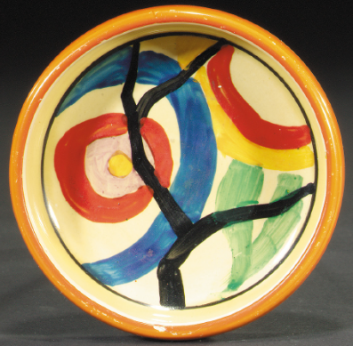
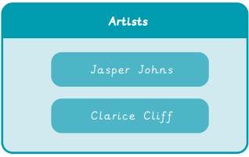
Year 1 Painting and Mixed Media – Colour Splash
What I will learn next:
I can mix a variety of shades of a secondary colour.
I can make choices about amounts of paint to use when mixing a particular colour.
I can match colours seen around me.
I can create texture using different painting tools.
I can make textured paper to use in a collage.
I can choose and shape collage materials eg cutting, tearing.
I can compose a collage, arranging and overlapping pieces for contrast and effect.
I can add painted detail to a collage to enhance/improve it.
What I already know:
I can explore paint, using hands as a tool.
I can describe colours and textures as I paint.
I know what happens when paint colours mix.
I can make natural painting tools.
I can look at natural materials eg paint, water for painting.
I can explore paint textures, for example mixing in other materials or adding water.
I can use paint to express ideas and feelings.
I can explore colours, patterns and compositions when combining materials in collage.
What I will learn now:
I can combine primary-coloured materials to make secondary colours.
I can mix secondary colours in paint.
I can choose suitable sized paint brushes.
I can clean a paintbrush to change colours.
I can print with objects, applying a suitable layer of paint to the printing surface.
I can overlap paint to mix new colours.
I can use blowing to create a paint effect.
I can make a paint colour darker or lighter (creating shades) in different ways eg. adding water, adding a lighter colour.

Slide 2
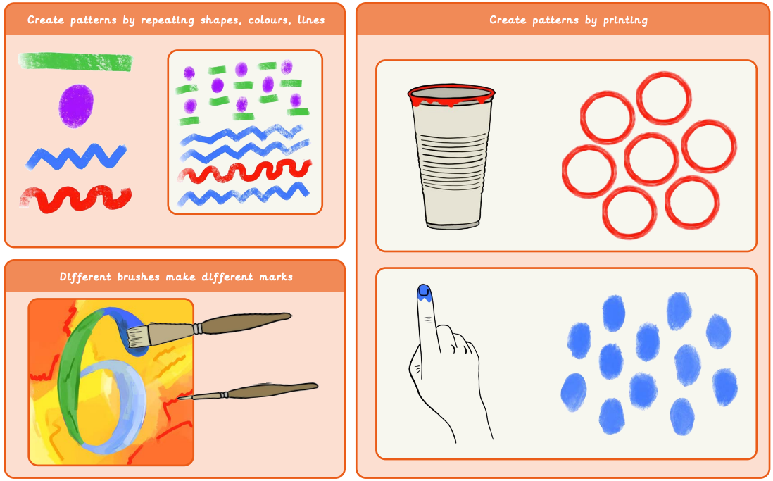
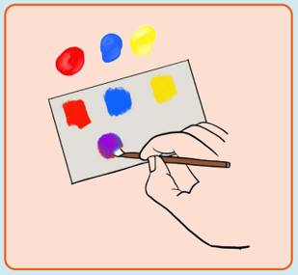
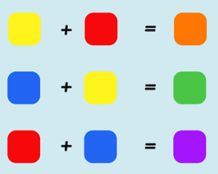
Vocabulary

