Slide 1
Next Steps in Reception 2023

Slide 2
Aims of this Workshop
Overview of our Curriculum
Timetables
A day in the life of your child
Learning With Parents
Reading Books
Forest School

Slide 3
Foundation Stage Profile
Prime Areas
The prime areas are those most essential for your child’s healthy development and future learning.
Communication and Language
Physical Development
Personal, Social and Emotional Development
Specific Areas
As children grow, the prime areas will help them to develop skills in four specific areas.
Literacy
Mathematics
Understanding the World
Expressive Arts and Design

Slide 4
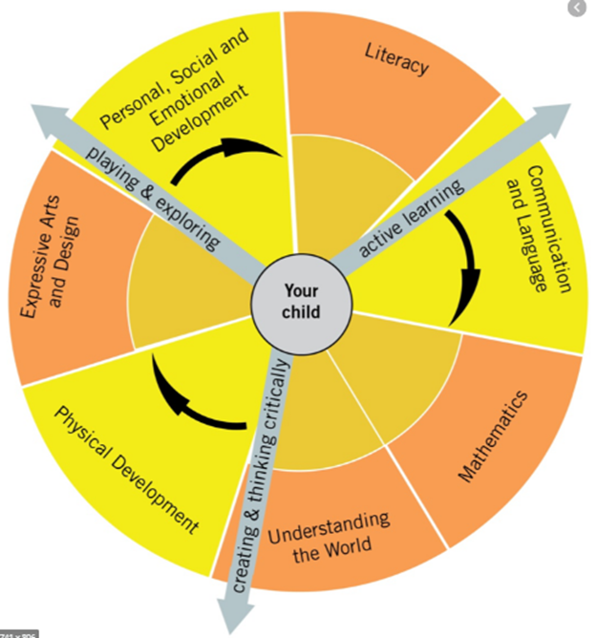
Characteristics of Effective Learning

Slide 5
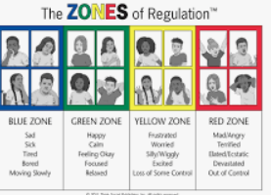
Programmes
PSE
Jigsaw
MindUp!
Zones of Regulation
Thrive
Maths
Maths Mastery
NCTEM – Mastery of Number
Language & Literacy
Read Write Inc Phonics
Understanding of the World
Developing Experts Science
Art & Design
Kapow

Slide 6
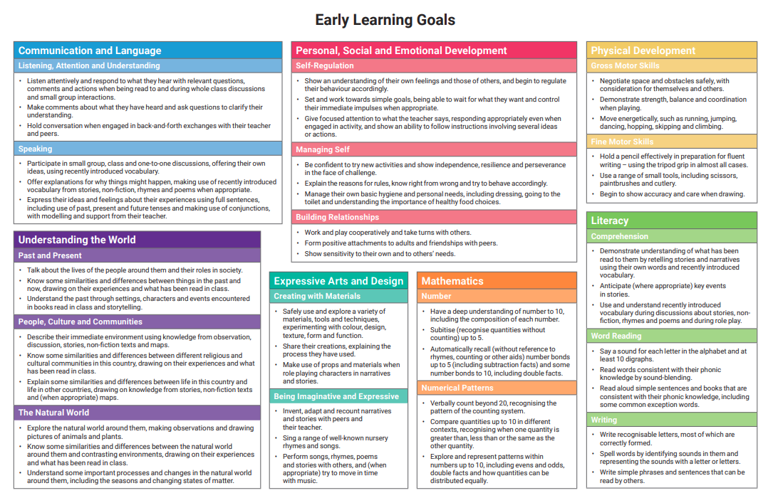

Slide 7
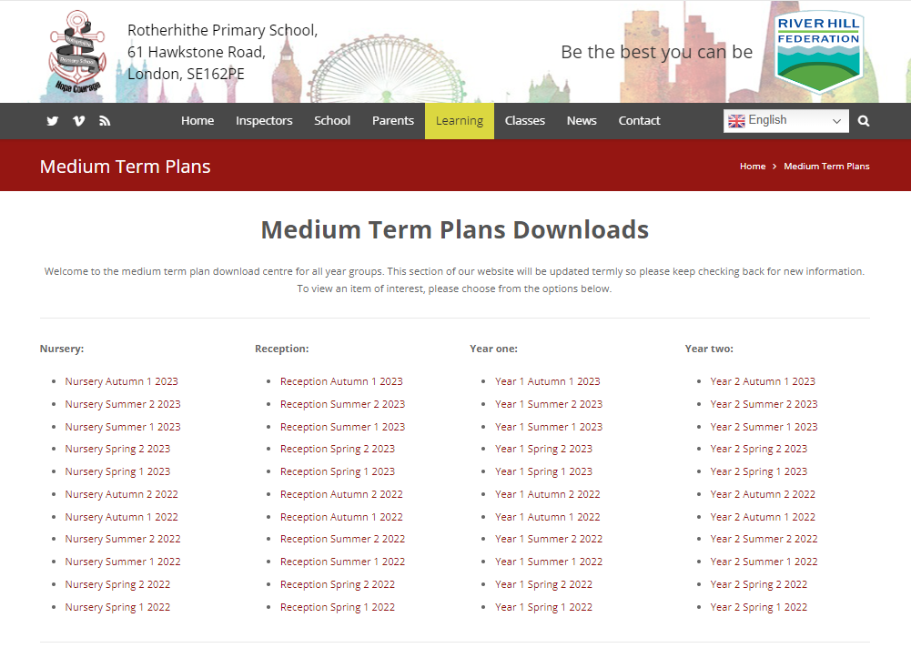
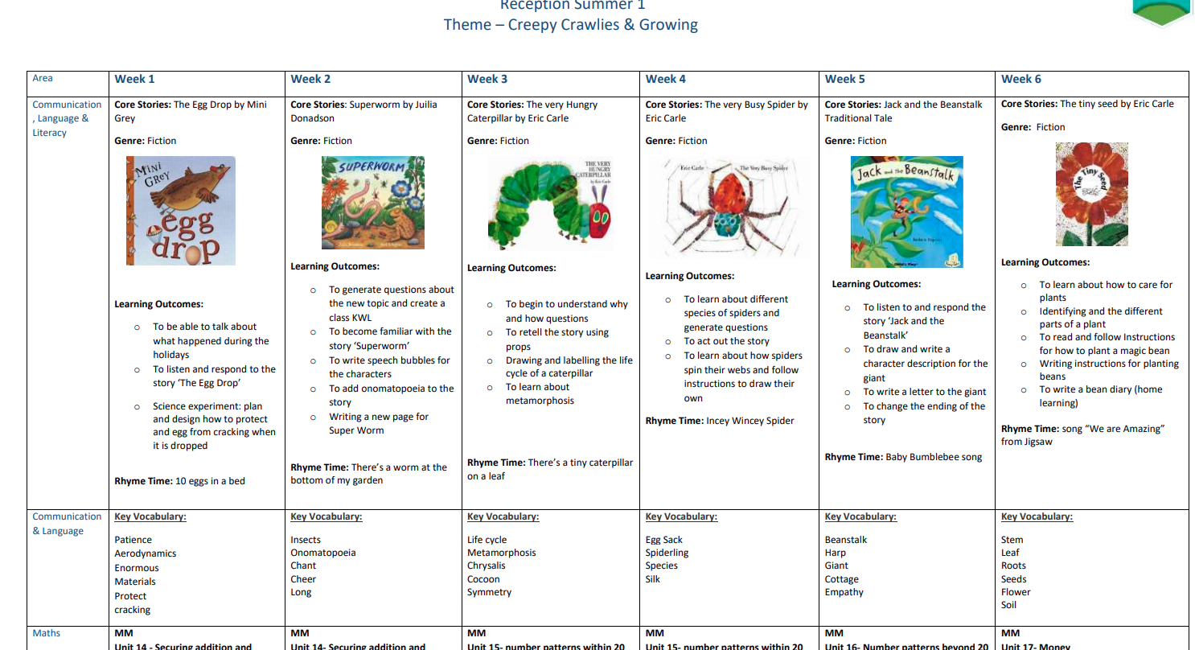
Termly Overviews

Slide 8
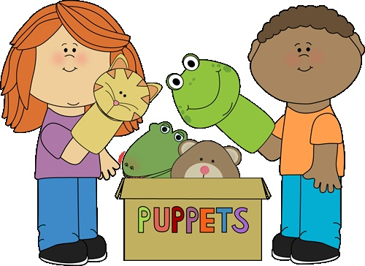
A Day in the life of...
Morning
9.00 whiteboard work, register, calendar
9.10 Maths
9.40 Free flow play
10.45 Tidy up time
11.00 Phonics
11.30 Lunch
12.15 Lunch Play & Book Club
Afternoon
1.00 carpet time: literacy/uw
1.30 Free Flow
2.30 tidy up time
2.45 carpet time: maths/pse/uw/story
3.00 getting ready for home

Slide 9
What happens in Free Flow
Child directed
Split provision across the rooms: role play, creative, construction, small world, science, writing, reading, maths
Open ended activities for children to choose
Adult Challenges
Activities linked to our core learning
Adult directed
Writing task in book once a week
Cross curricular activity linked to story
Reading
Maths activity

Slide 10
Timetable
 | Monday | Tuesday | Wednesday | Thursday | Friday
AM |  | Forest School | Penguin PE | Jellyfish PE Art Club | Reading Café
PM | Penguin Music | Forest School | Jellyfish Music | Art Club

Slide 11
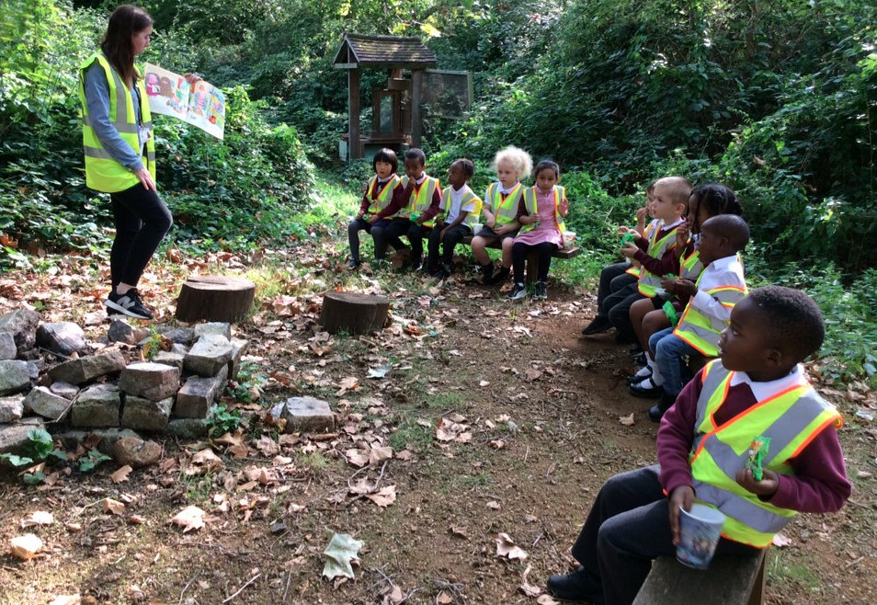
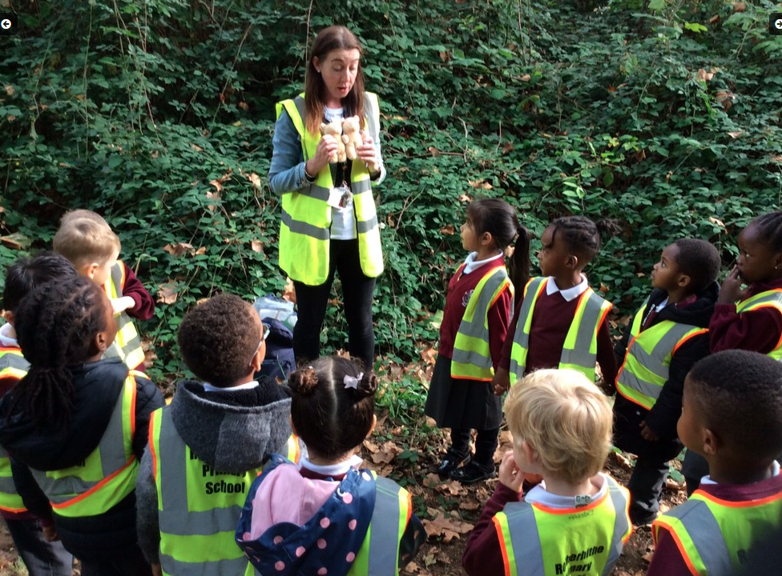
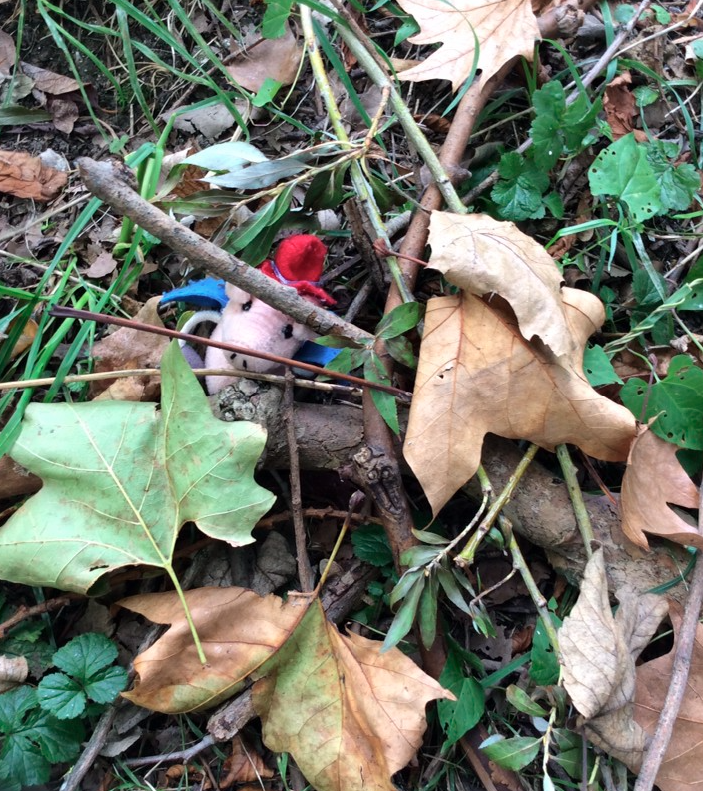
Forest School
Classes alternate each half term
6 week block
Half a class morning other half afternoon
Literacy learning linked
Southwark Park facility and on site

Slide 12
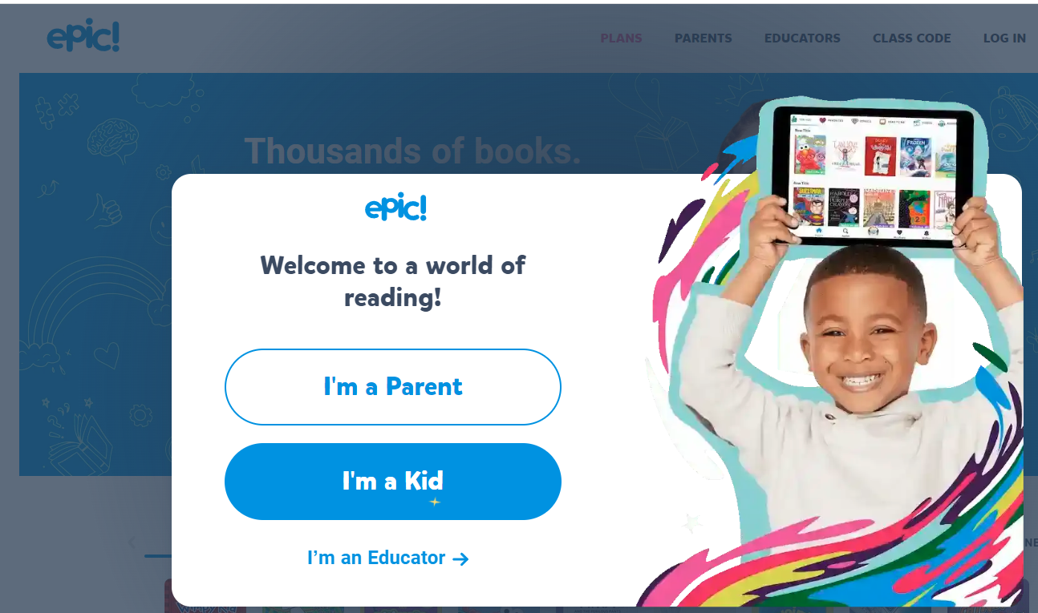
Reading Books
Purple Sticker – a book to share
Read Write Inc – matched to their phonic band/level
Please keep reading book in book bag everyday
Epic Reading
Reading Café every Friday Morning

Slide 13
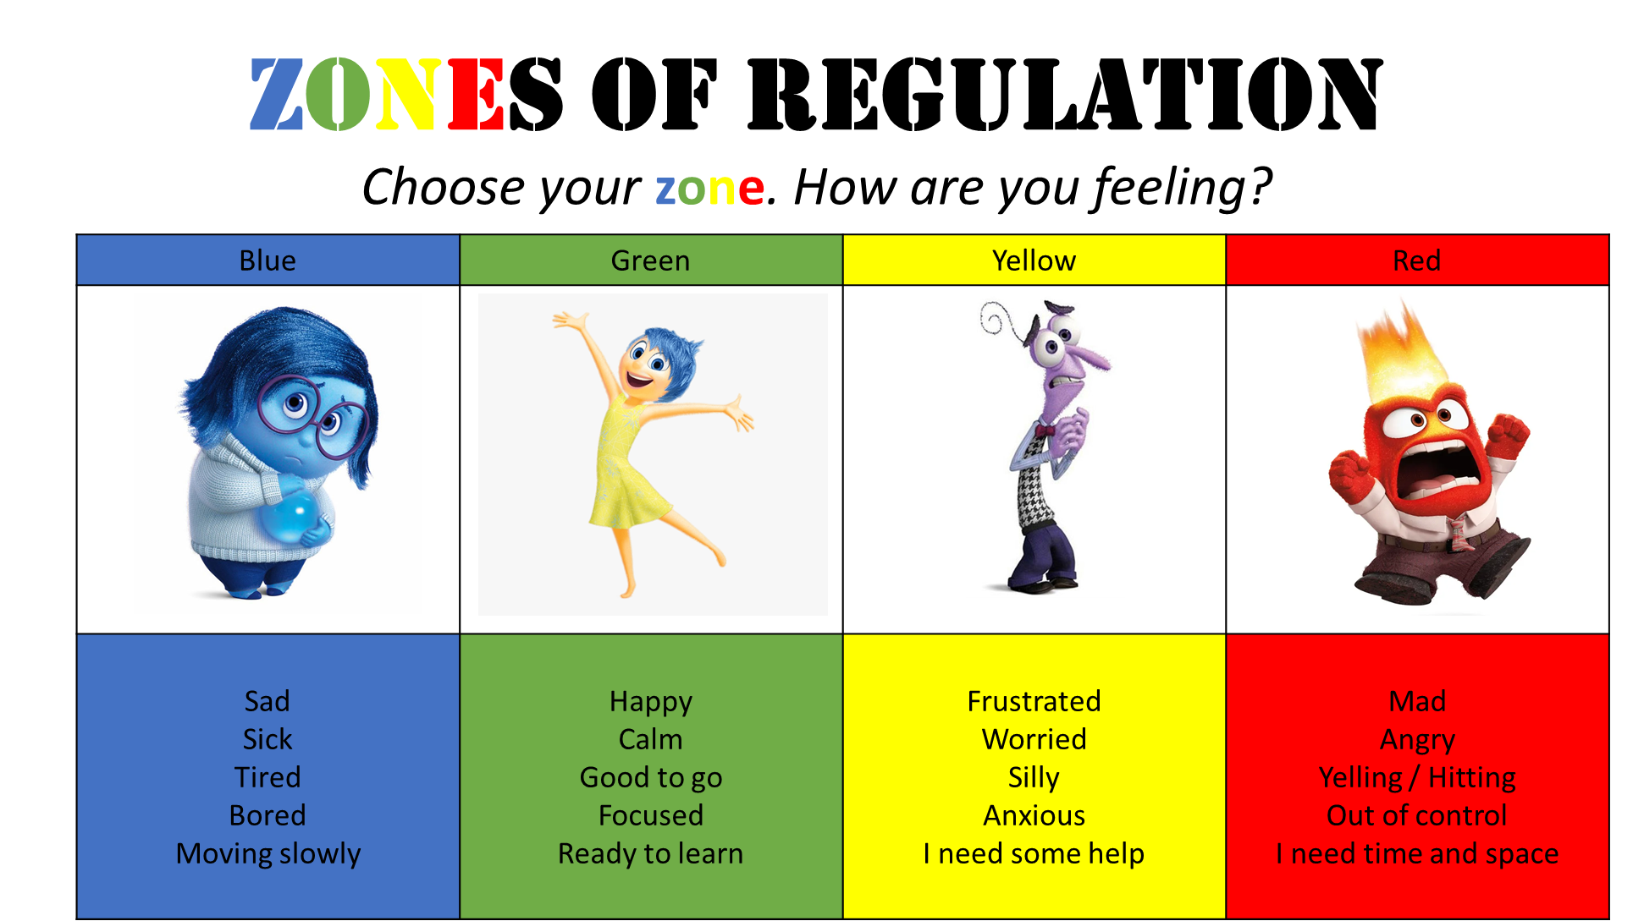
Behaviour
Sun & Rainbow
Conflict Resolution
Golden Globes
Brain Breaks
Calm Areas
Thrive Approach
See School Website for Behaviour Policy

Slide 14
Homework
Learning with parents
topics set every week alternating between a language task and a maths task
Phonics videos on Tapestry
Moving forward these video links will be tailored to the group your child is in and based on their next steps
Reading
1. Purple sticker for – Book to Share
2. Book matched to their phonic level

Slide 15
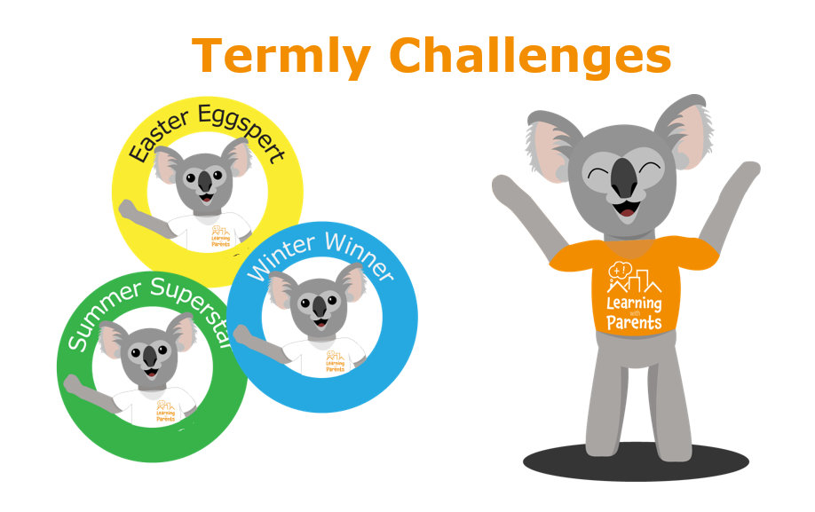
Learning with Parents

Slide 16
Phonics
Parent Workshop
Please join us on 14th November 3.30

Slide 17
Thank you for attending
Any questions?

