Slide 1
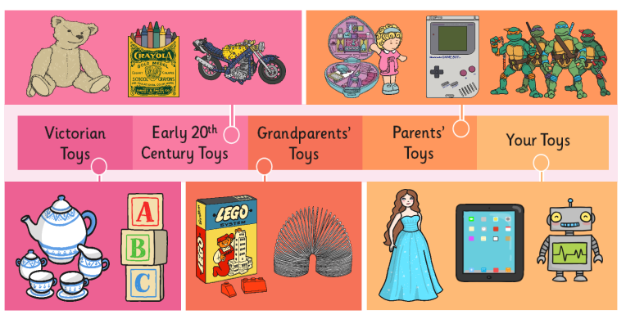
Rotherhithe Primary - Year 1 – toys now and then
What I should already know
To know there are different types of toys that move in different ways. To understand which toys I played with as a baby and a toddler.
What will I learn in this unit?
To know how long toys have existed. What toys were made of in the past. What toys were played with in the past. What modern toys are made from. How modern toys are different to the past.
What I will learn next
Local history- Surrey portal of Rotherhithe tunnel
Key Words
20th century | 20th century The 20th century was 1900-1999.
21st century | We are in the 21st century. It started in the year 2000 and will end in 2099..
metal toys | Toy soldiers and some spinning tops were made out of metal.
modern | Things made now or recently.
paper toys | Some toys, like paper windmills, were made out of paper.
past | Objects and things that happened before now.
plastic toys | Most modern toys are made of plastic.
wooden toys | Boats, train sets and cup and ball were all made of wood
TIMELINE
19th century | 20th century | 21st century
Toys: wooden dolls, wooden doll houses, tea sets, ball and cup, spinning top, toys soldiers, leather footballs. | Toys: teddy bears, Barbie dolls, Action Man, electronic toys, computers, games consoles. | Toys: handheld games consoles, virtual reality.

