Slide 1
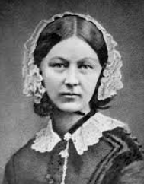
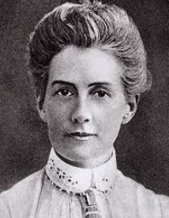
Rotherhithe Primary- Year 2 – Female Pioneers
What I should already know
Our local history of Rotherhithe How people and events in the past have changed how we live today
What will I learn in this unit?
Study Florence Nightingale’s life To know how Florence Nightingale changed modern nursing To study the life of Edith Cavell To know why Edith Cavell sacrificed her life
What I will learn next
Queen Elizabeth 1st
Key Words
Crimenan war | A war that was fought between 1853 and 1856 in Russia. On one side were Britain, France, and Turkey, and on the other side was Russia
cleanliness | When there is no dirt, dust, stains or smells
executed | To be sentenced to death
heroine | A brave woman who is admired
injured | Hurt or harmed by something or someone
medicine | A pill or liquid taken to prevent or cure an illness
Nurse | A person trained to care for the sick, especially in a hospital
Florence Nightingale
Edith Cavell
TIMELINE- Edith Cavell
1865 | 1897 | 1914 | 1915 | 1915
Born 4th December | She worked as a nurse during a deadly typhoid outbreak | She went to Belgium to help WW1 victims | She was discovered sheltering allied soldiers | Executed for treason 12th October
TIMELINE- Florence Nightingale
1820 | 1837 | 1851 | 1853 | 1854 | 1856 | 1860 | 1910
Florence is born on the 12th of May | She campaigned for better hospitals | She became a nurse | The Crimean war broke out | Florence went to Turkey and ensured hospitals were clean | The Crimean war ended | The Nightingale training school for nurses was opened | Florence died on the 13th August

