Slide 1
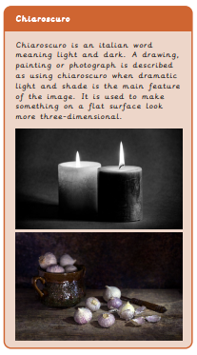
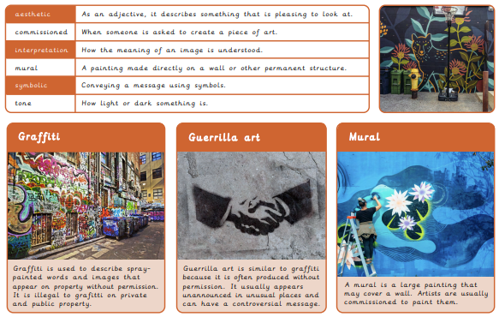
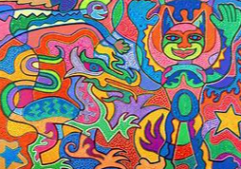
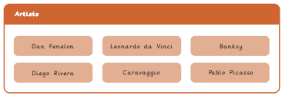
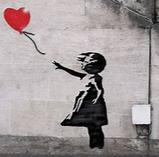
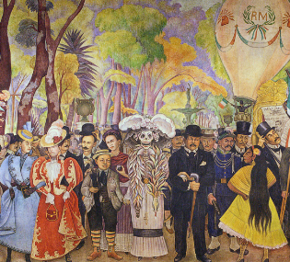
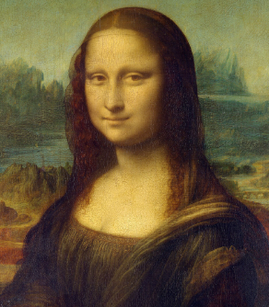
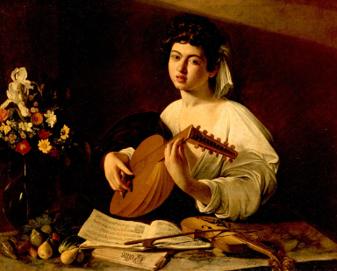
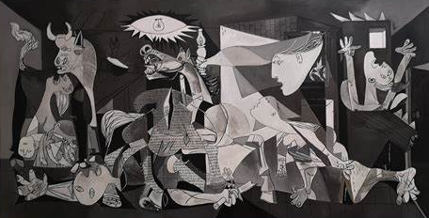
Year 5/6 Drawing – Make my voice heard
What I already know:
Analyse an image that considers impact, audience and purpose. Draw the same image in different ways with different materials and techniques.
Make a collagraph plate.
Make a collagraph print.
Develop drawn ideas for a print.
Combine techniques to create a final composition.
Decide what materials and tools to use based on experience and knowledge
What I will learn now:
Use symbolism as a way to create imagery.
Combine imagery into unique compositions.
Achieve the tonal technique called chiaroscuro.
Make handmade tools to draw with.
Use charcoal to create chiaroscuro effects.
What I will learn next:
To use a range of techniques to record their observations in sketchbooks, journals and other media as a basis for exploring their ideas.
To use a range of techniques and media to increase their proficiency in the handling of different materials
To analyse and evaluate their own work, and that of others, in order to strengthen the visual impact or applications of their work

