Slide 1


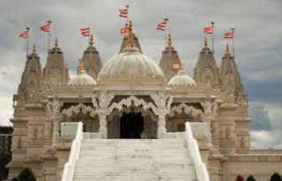
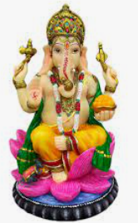
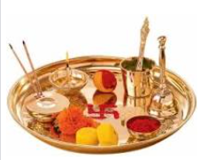
Rotherhithe Primary- Year 3/4
Big Question: What is special to me and the people in my community?
Topic: How and why do Hindus worship at home and in the Mandir?
What I should already know
To know what happens at the festival of Holi. To understand the hidden meaning of stories linked to Holi. To know what Holi shows about what Hindus believe about God.
What will learn in this unit?
To identify what Hindus will learn about God/s To consider why a home shrine is Important to Hindus. To consider the importance of Hindu worship at home and at the Mandir. To consider how the beliefs of Hindus are similar to my own.
What I will learn next
To explain and link different viewpoints from Hindu people about what God is like. To explain the impact of believing in one god in many forms for a Hindu person.
Mandir
Aum | This sound (sometimes written as ‘Om’) is said to represent the divine.
Mandir | A Hindu temple.
Murti | An image in the form of a small statue
Prasad | Something material – usually food, but sometimes flowers, water or ash - which has been offered to the deities and which is then received back by worshippers as a symbol of receiving divine blessing
Puja | The act of worship
Puja Tray | A metal tray used during Puja.
Topic Overview
In this unit, you will explore Hindu worship at home and in the Mandir, and explore some of the objects used in worship and their symbolism, and how these have an impact on daily life.
Om
Murti
Puja Tray

