Slide 1
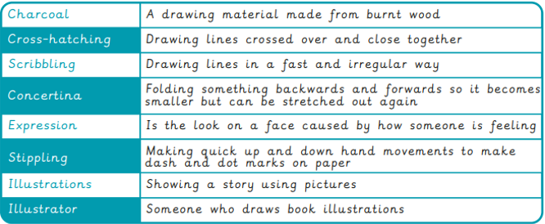
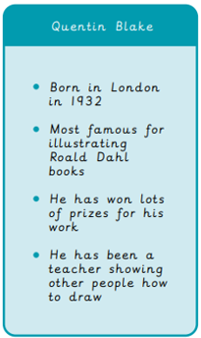
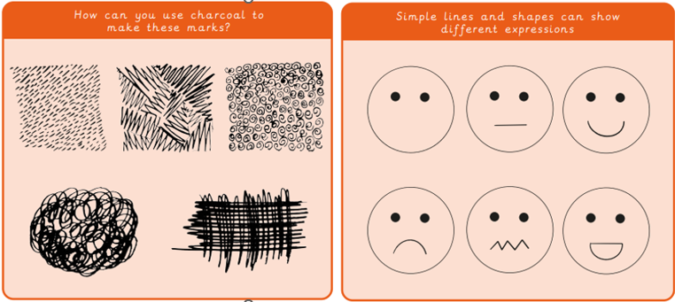
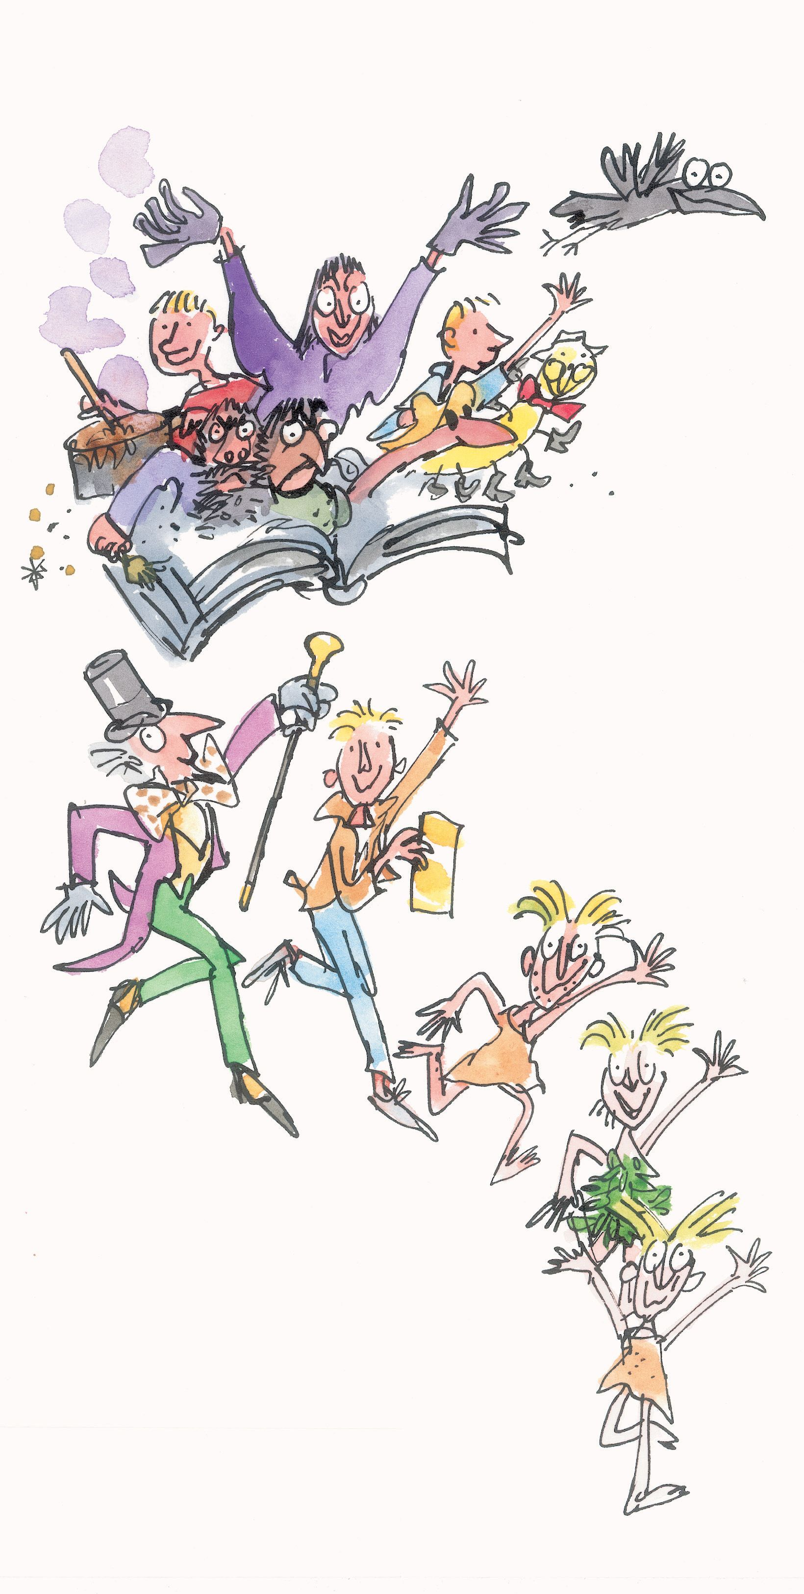
Year 2 Drawing – Tell a story
What I already know:
Hold and use drawing tools in different ways to create different lines and marks.
Create marks by responding to different stimulus such as music.
Overlap shapes to create new ones.
Use mark making to replicate texture.
Look carefully to make an observational drawing.
Complete a continuous line drawing.
What I will learn now:
Use different materials and marks to replicate texture.
Manipulate materials and surfaces to create textures. Eg scratching with tools or blending with fingers.
Use marks and lines to show expression on faces.
Make a concertina book.
Use drawing to tell a story.
Use charcoal to avoid snapping and to achieve different types of lines.
Use drawing pens.
What I will learn next:
Hold and use drawing tools in different ways to create different lines and marks.
Create marks by responding to different stimulus such as music.
Overlap shapes to create new ones.
Use mark making to replicate texture.
Look carefully to make an observational drawing. Complete a continuous line drawing.

