Slide 1
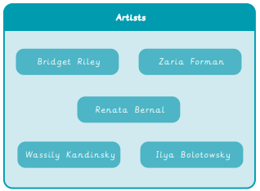
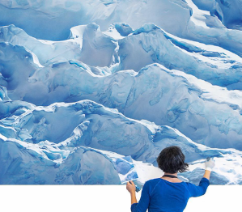
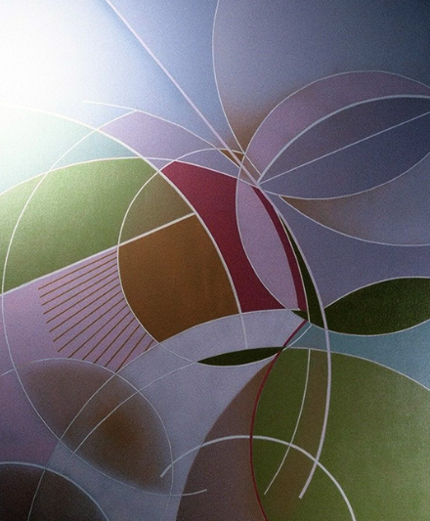
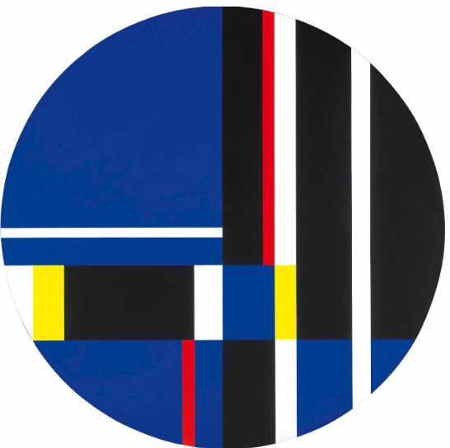
Year 1 Drawing – Make your mark
What I already know:
I can make a mark.
I can make a pattern
I can say what is the same and different between a mark made by a pencil and a crayon
I can make large and small movements when drawing
I can look carefully when drawing
I can use different materials when drawing.
What I will learn now:
I can make different lines and marks
I can overlap shapes to make new ones
I can make different textures
I can draw what I see by observing carefully
I can make a continuous line drawing
What I will learn next:
I can create tone by shading.
I can create even tones when shading.
I can make texture rubbings. I can create art from textured paper
I can hold and use a pencil to shade.
I can tear and shape paper.
I can use paper shapes to create a drawing
I can make careful observations to accurately draw an object.
I can create abstract compositions to draw more expressively.

Slide 2
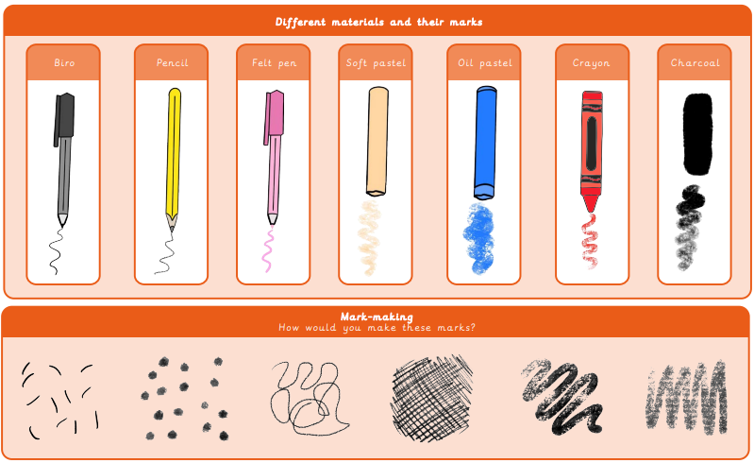
Vocabulary
Geometric | Shapes with straight lines, angles and point
Irregular | When shapes or lines are not the same size
Mark-making | Creating different lines, patterns and shapes
Observation | To look at something carefully
Regular | A consistent size or pattern

