Slide 1
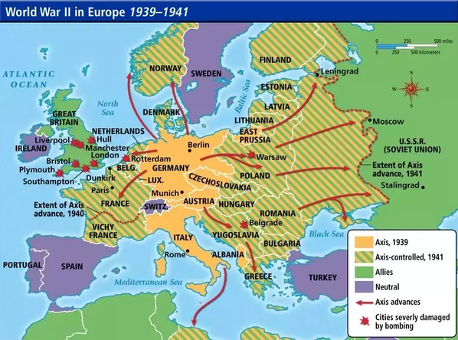
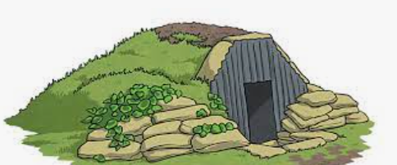
Rotherhithe Primary- Year 5/6 – World War II
What I should already know
Harriet Tubman
What will I learn in this unit?
When the war started/ended The countries that fought in the World War What rationing was Which places were bombed and why What the Blitz was and who was affected What evacuation meant What D-Day was Why propaganda was important The role of men and women during the war How the Second World War changed the world
What I will learn next
Ancient Maya
Key Words
Air raid shelter | A building to protect people from bombs dropped by planes
Allies | Countries which fought on the British side (USA, Great Britain, France, Russia (1941-1945)
Anderson Shelter | Made of corrugated iron. Usually at the end of a garden
Axis | Countries which fought on the German side (Italy, Germany, Japan, Russia (1939-1941)
Blitz | Series of aerial bombing raids on the UK, mainly cities including London, Bristol, and Nottingham
evacuee | Someone who was evacuated, moved from a dangerous area to a safer place (normally from cities to rural areas)
Fascism | Right wing political view associated with not allowing opposition and total control by a dictator
Anderson shelter
TIMELINE
SEP 1, 1939 | SEP 3, 1939 | JAN 1940 | MAY-JUN 1940 | JULY 1940 | DEC 7, 1941 | JUN 6, 1944 | APR 30, 1945 | MAY 7, 1945 | AUG 1945 | SEP 2, 1945 | JULY 1954
Germany invades Poland | Britain & France declare war on Germany (WWII begins) | Rationing introduced across the UK | Dunkirk evacuated and France surrenders to Germany. Germany uses blitzkrieg to take over much of Western Europe | Germany launches air attacks on Great Britain. Germany, Italy, Japan signed the Tripartite Pact, creating the axis alliance | The Japanese attack the US navy in Pearl Harbor. The next day, the USA enters the war fighting with the allies | D-Day and the Normandy invasion. Allied forces invade France and push back the Germans. | Adolf Hitler commits suicide. | Germany surrenders & victory in Europe is declared the next day. | Atomic bombs dropped on Hiroshima & Nagasaki, Japan by the US killing approximately 226,000 people | Japan surrenders, signalling the end of WWII | Rationing ends in the UK

