Slide 1
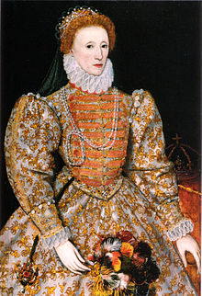
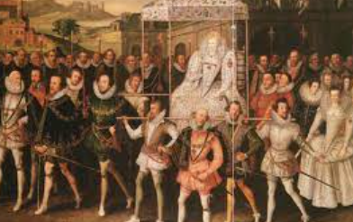
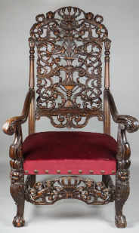
Rotherhithe Primary- Year 2 – Queen Elizabeth 1st
What I should already know
Study Florence Nightingale’s life To study the life of Edith Cavell
What will I learn in this unit?
Why Elizabeth became Queen of England. Details of Elizabeth’s religious settlement. Whether Elizabeth was popular or not. How English culture developed in the 1500s. Why the Spanish Armada was defeated.
What I will learn next
Local history
Key Words
coronation | The ceremony of crowning a king or queen
heir | A person legally entitled to the property or rank of another on that person's death
majesty | A royal person
monarch | A person who reigns over a kingdom or empire such as a king or queen
reign | The period of one monarch’s rule
throne | A special chair for a king or queen, or another very important person
Queen Elizabeth 1st
coronation
throne
Timeline
1533AD | 1558AD | 1587AD | 1588AD | 1603AD
Elizabeth born to Anne Boleyn | Crowned Queen of England following the death of her sister Mary | Mary Queen of Scots executed | The Spanish Armada | Elizabeth dies

