Slide 1
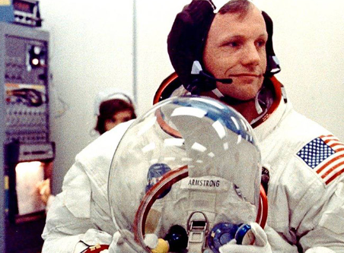
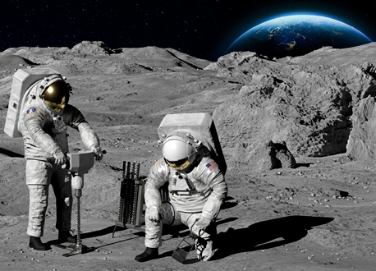
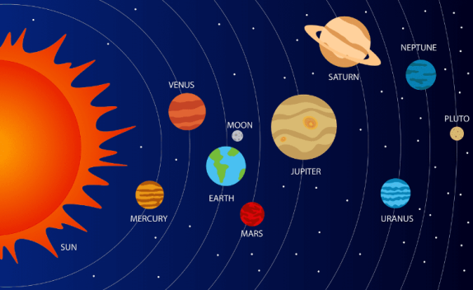
Rotherhithe Primary - Year 1 – Neil Armstrong
What I should already know
Important things happened in the past Show knowledge and understanding about the past in different ways
What will I learn in this unit?
Who the first men to travel to the moon were Explain what you know about the 1969 moon landings, including what effect the landings had on history. Why the moon landing was and still is an important historical event
What I will learn next
Toys now and in the past
Key Words
Apollo 11 | The spaceflight that first landed humans on the moon
Astronaut | An astronaut or cosmonaut is a person that travels into space.
Moon | The moon orbits (goes around) the Earth.
NASA | The group of people in America in charge of flights into space.
Neil Armstrong | The first man to walk on the moon.
Mission | An important job to be completed.
Solar system | Our solar system consists of the sun and the 8 planets that orbit it.
Neil Armstrong
Astronauts on the moon
Solar System
TIMELINE
1930 | 1946 | 1962 | 1966 | 1969 | 1971 | 2005 | 2012
Neil Armstrong born. | Armstrong got his first pilot’s licence. | Armstrong became an astronaut. | Armstrong had his first space flight. | Apollo 11 mission and first on the moon. | Armstrong resigned from NASA. | Armstrong’s biography published. | Armstrong died.

