Slide 1


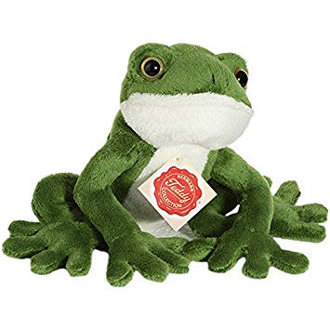
Early Phonics Workshop
Nursery
17th March 2023

Slide 2
Nursery Phonics
Foundation for reading is speaking and listening skills
Activities in Nursery help develop their sound discrimination skills. The aim is to get children to tune into sounds and begin to break words down by listening, creating and playing with sounds.
Before your child can learn individual letter sounds, they will learn to hear letter sounds in speech and have fun making sounds and noises.

Slide 3
Phase 1
Environmental sounds ​
Instrumental sounds​
Body percussion​
Rhythm and rhyme​
Alliteration ​
Voice sounds​
Oral blending and segmenting

Slide 4
Alliteration
This aspect brings in the introduction to letters and the alphabet
Sound of the week
Silly Soup
I spy
Exaggerate the first sound
Name your toys
Go on a sound hunt

Slide 5



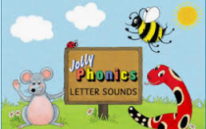
Voice Sounds
Phase 1 Videos – Letters and Sounds (letters-and-sounds.com)
Start 15 6.18

Slide 6
Segmenting and Blending
Break up sounds in words – put sounds in words together
Clap or stamp the rhythm of spoken words
Robot Voice games
6

Slide 7

Phonics
Letter Recognition
Not alphabet names – letter sounds
Not in alphabetical order
Lower case letters only

Slide 8
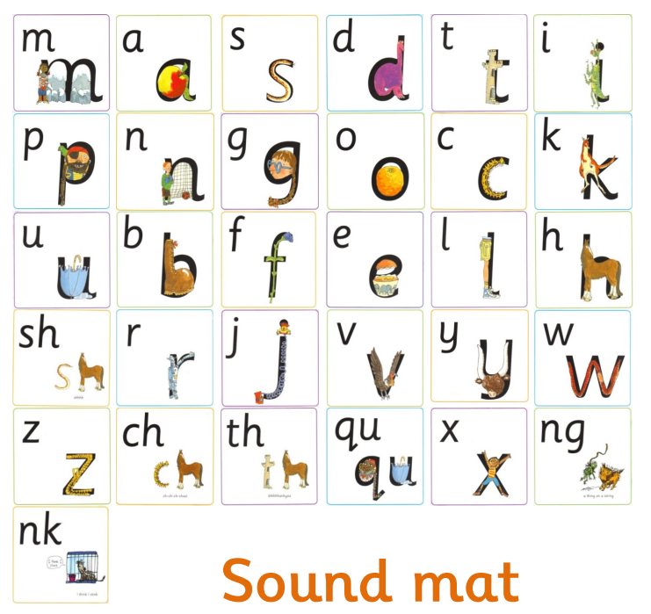

Slide 9
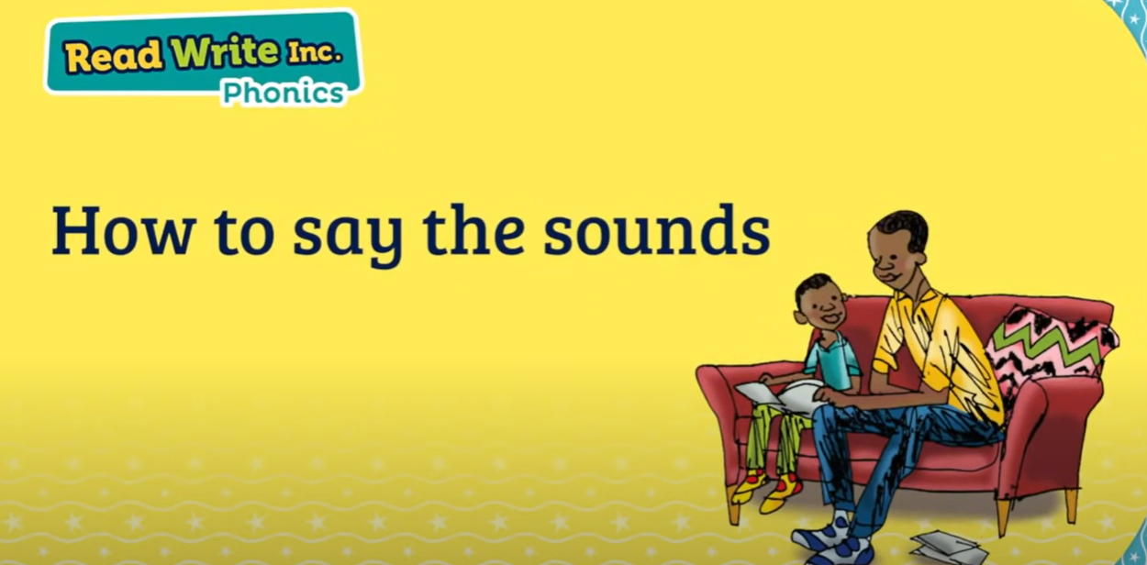
Parent video: How to say the sounds - YouTube

Slide 10
Writing
Scribbles can carry meaning accept all forms of communication
Draw pictures and make it meaningful
Only lower-case letters
Can practise copying letters of their name
Use the rhyme for the letters
See hand out

Slide 11
Sum up
Teach letter sounds not names
Play games to hear initial sounds in words
Sing nursery rhymes
Point out rhyming words in books
Read every day, children love repetition
Listen to sounds and make sounds

Slide 12
Thank you for attending our Phonics Workshop
Any questions?

