Slide 1
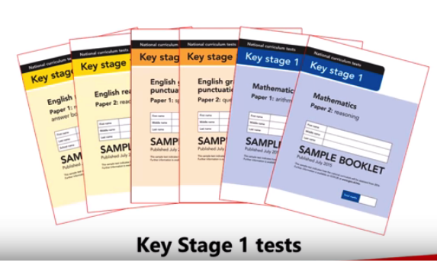
KS1 SATs
Information for Parents
Rotherhithe Primary School

Slide 2
When are the tests?
KS1 tests must take place in May.
Each school can choose their own assessment timetable. We carefully spread the tests out across 2-3 weeks. These will start on Friday 12th May.
We aim to administer the tests in small groups away from the rest of the class to ensure it is as stress-free as possible. Pupils can take breaks if needed.

Slide 3
Which Subjects?
Reading Test
Paper 1 and Paper 2
Mathematics Test
Paper 1 Arithmetic test
Paper Reasoning test
Writing and Science are teacher assessed

Slide 4
Reading

Slide 5
Reading

Slide 6
Mathematics

Slide 7
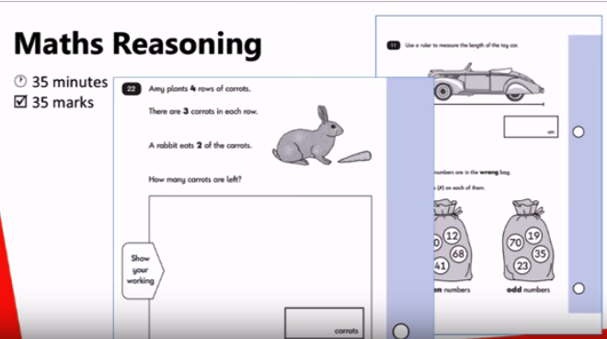
Mathematics

Slide 8
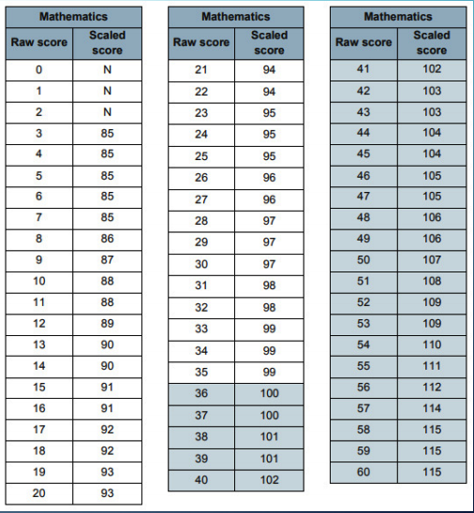
Scaled Score
Notes:
The results of the two papers are added to give a raw score. We then use a conversion chart which gives us a scaled score. This pass mark changes each year

Slide 9
KS1 SATS 2023
Attainment judgements for Reading, Writing and Mathematics
GDS- working at greater depth
EXS- working at the expected standard
WTS – working towards the expected standard
PK (1-4) working below Key stage 1 standard
Science:
EXS – has met the expected standard
HNM- had not met the expected standard

Slide 10
English Writing

Slide 11
English Writing

Slide 12
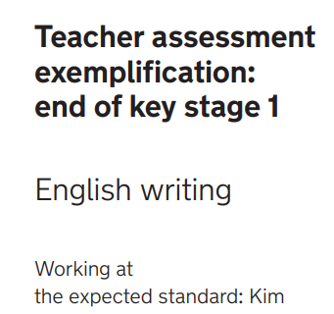
Exemplification samples
At the expected standard

Slide 13
Reading and spelling

Slide 14
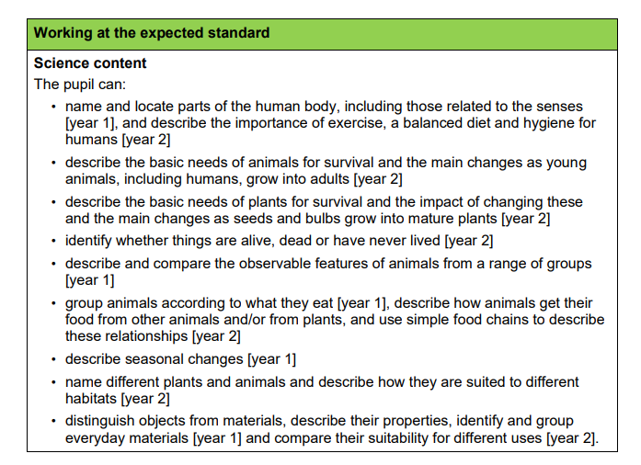
Science

Slide 15
The Interim Framework
Please look at the examples provided:
Notes:
Your child’s teacher will consider lots of different forms of evidence (book work, tests, observations etc) to determine their final grade.
The assessment criteria for working towards, expected and greater depth is set out in the Interim Framework. In KS1 teacher’s use the tests to support their final judgments.

Slide 16
What if my child has additional needs?
We can make special arrangements:
Additional time
A scribe
A reader (in the mathematics reasoning tests)

Slide 17
How can I help?
Read every day with your child and talk about what is happening in books.
Practice common exception words using a look cover write check approach.
Practice number facts.
Make any home learning fun.
Ensure they are well rested and get a good night sleep.
Keep the children well hydrated with water.

