Slide 1
Secondary School Applications
Transfer date September 2023

Slide 2
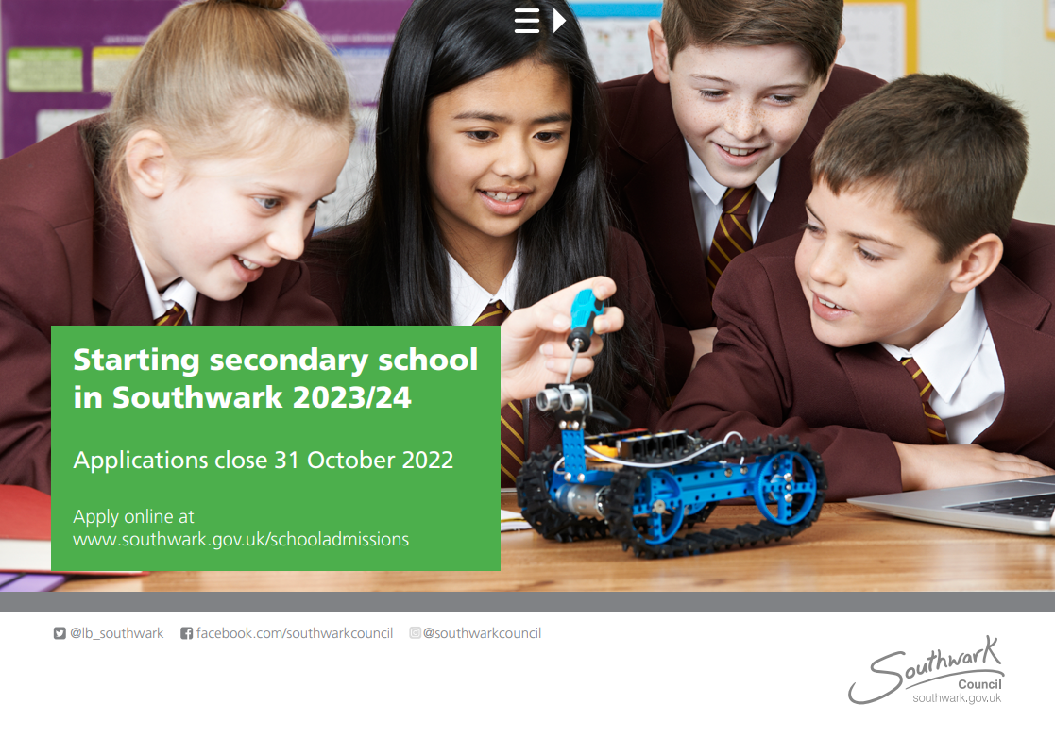

Slide 3
Before you choose your school
Look at school brochures and websites
Look at the most recent Ofsted www.gov.uk/government/organisations/ofsted

Slide 4
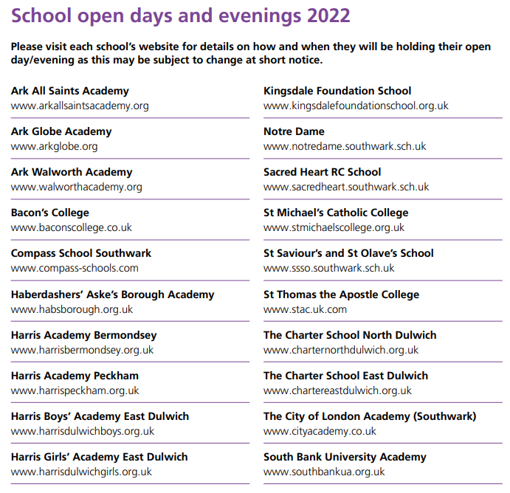
Open Days
The Secondary School brochure does not include any dates, so you will have to check for updates on school websites. Open days are often the first alert you will see when you look at a website.
If you download the brochure p8 lists all schools. If you click the hyperlink and it will take you straight to the schools website.

Slide 5
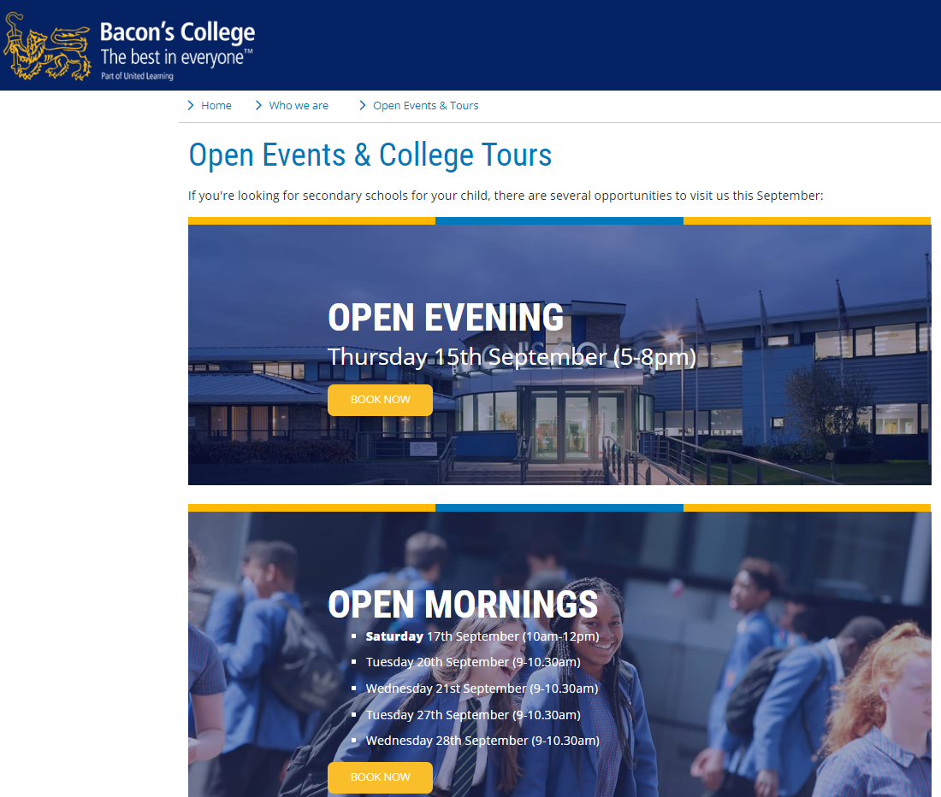

Slide 6
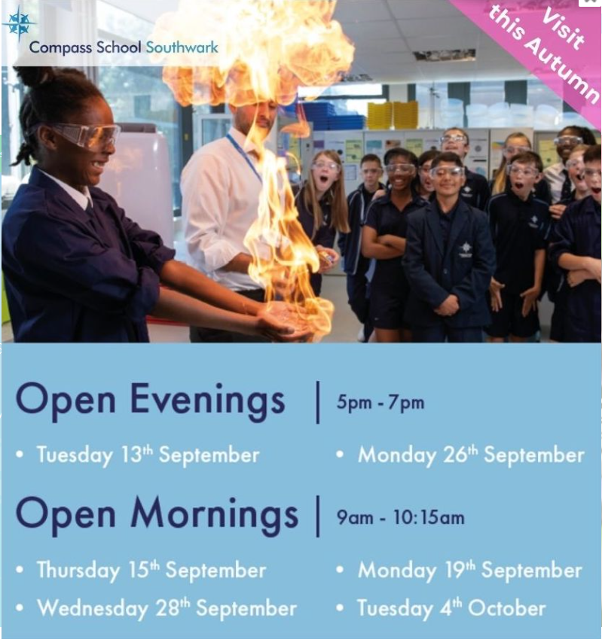

Slide 7
Some websites have admissions video- e.g Haberdasher’s Academy Trust

Slide 8
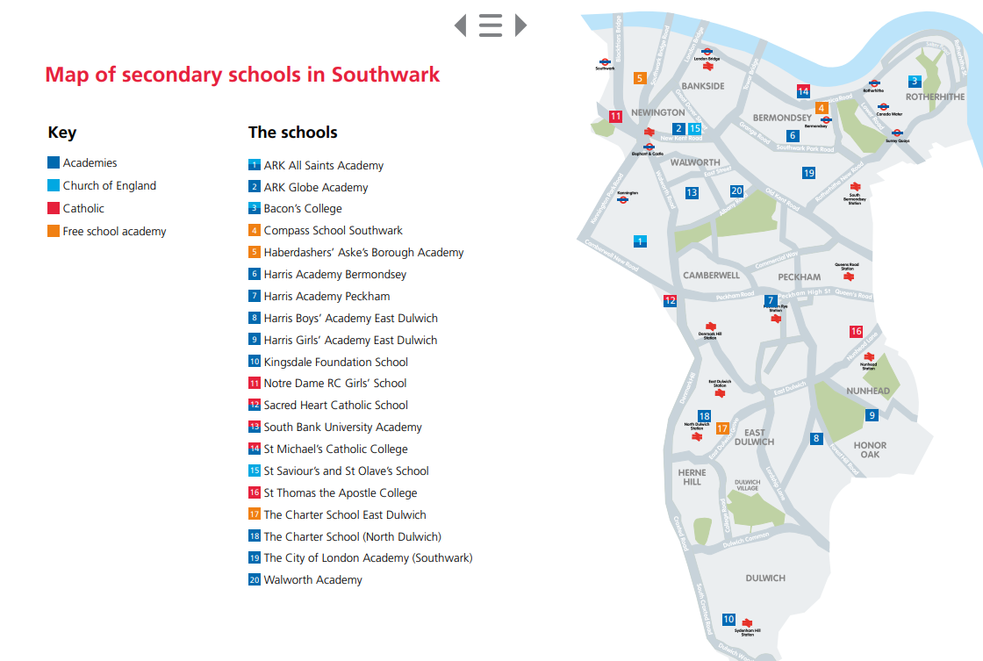
Page 53 of the brochure provides a map setting out the secondary schools within the borough.

Slide 9
Types of secondary schools
Voluntary aided schools: There are three voluntary aided secondary schools in Southwark. The school’s governing body is responsible for their admissions and decides how pupils are admitted. (Notre Dame, St Saviour’s and St Olave’s School, St Thomas the Aspotle)
Academies: There are 14 academies in Southwark. The Academy Trust is responsible for school admissions and decides how pupils are admitted.
Free school academies: There are three secondary free school academies in Southwark. The school’s governing body is responsible for school admissions and decides how pupils are admitted. (Compass, Haberdashers Aske Borough, Charter School EastDulwich)

Slide 10
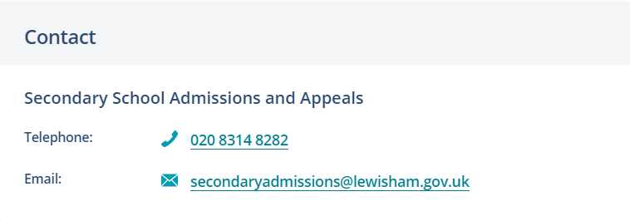
Starting secondary school in Lewisham
Website link for Lewisham secondary school admissions: https://lewisham.gov.uk/myservices/education/schools/school-admission/applying-to-start-secondary-school

Slide 11
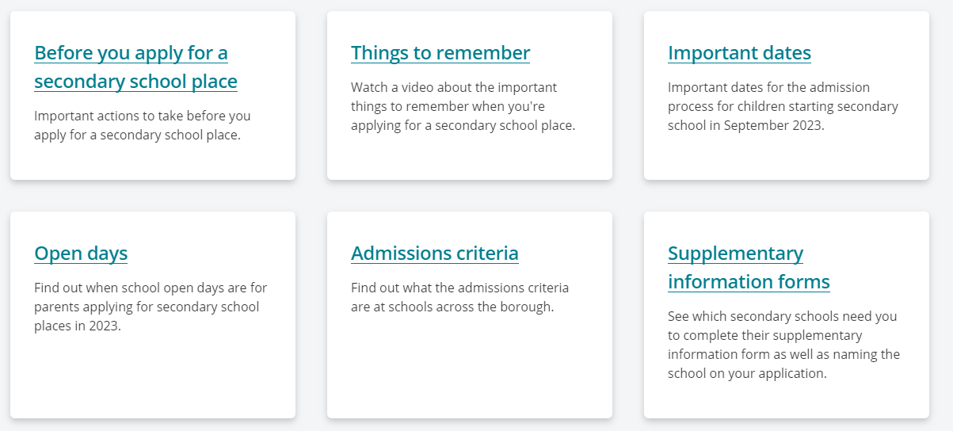
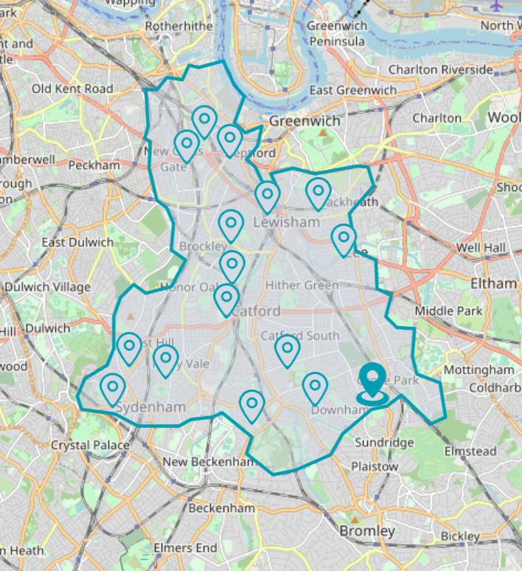
Lewisham links are easy to find on the website

Slide 12
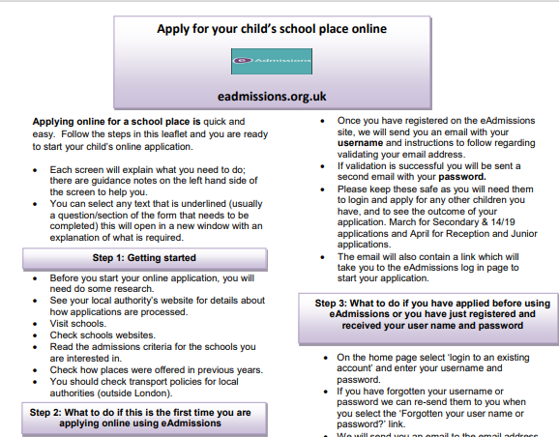

Slide 13
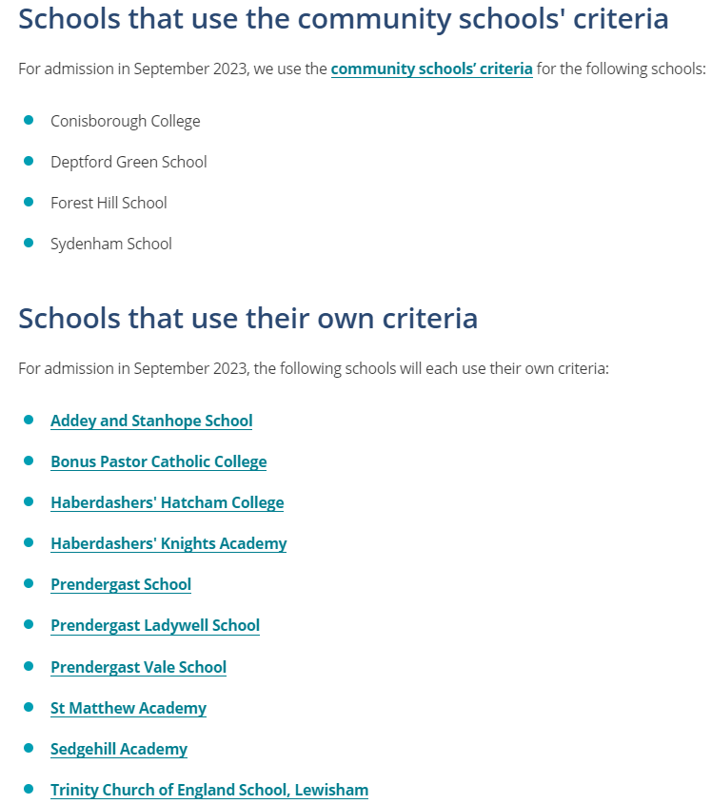

Slide 14
You can also sign up to receive date reminders via an email alert

Slide 15
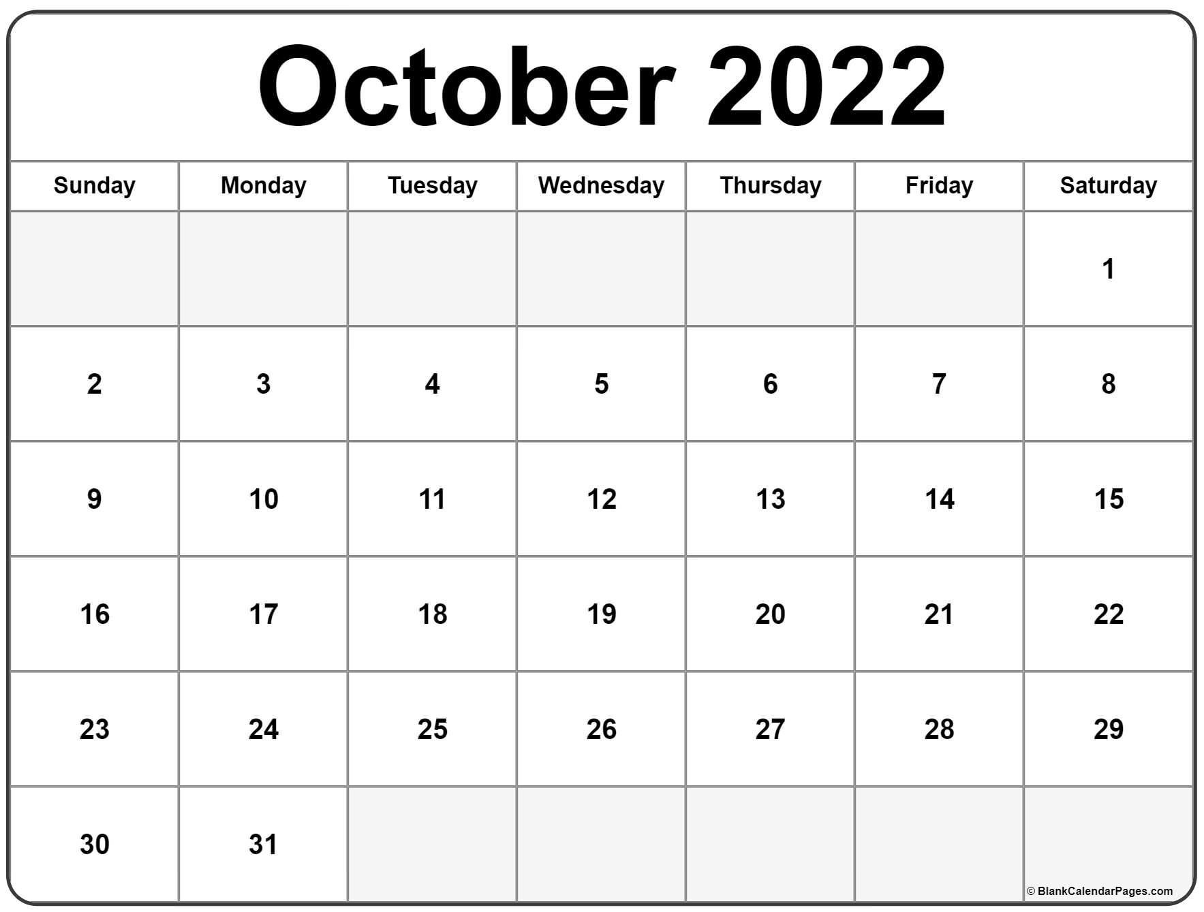
Key Dates
You can apply on line from 1st September 2022
Closing date Monday 31st October 2022 at 11:59pm
Aim to have completed your application by Friday 21st October
Final deadline

Slide 16
Confirmation of school offer
Applicants who apply on time will receive their child’s offer of a school place by email on Wednesday 1st March 2023 after 5pm. This email will also include information on what to do next.
Applicants can also view the outcome of their application during the evening at www.eadmissions.org.uk

Slide 17
Rejecting an offer
Rejection: Wednesday 15th March 2022 rejection of offers must be returned by this date or they will automatically be accepted.
Should you wish to reject the offer of a school place allocated to your child, you must notify the school admissions team by email at schools.admissions@southwark.gov.uk and include your unique application reference.
Waiting list that remain open until the 31st August 2022. If offered a place on a waiting list you have 5 days to accept the offer.
Appeals: Check dates of appeal hearings with individual schools. For further information about the appeals process contact Southwark Council’s school admissions team on 020 7525 5337 or by obtaining a copy of the School Admissions Appeals Code from the Department for Education (DfE), contact details on page 48 of the brochure.
If you miss these dates, your chances of being offered a place at a preferred school will be reduced.

Slide 18
How to apply
Application for all London boroughs is completed online and this is the same across London.
If you are a Southwark resident through
www.southwark.gov.uk/schooladmissions
Lewisham resident:
https://lewisham.gov.uk/myservices/education/schools/school-admission
Southwark Council
libraries offer free access to the internet.
Visit:
www.southwark.gov.uk/libraries or call
Southwark Council’s customer service centre on
020 7525 5000

Slide 19
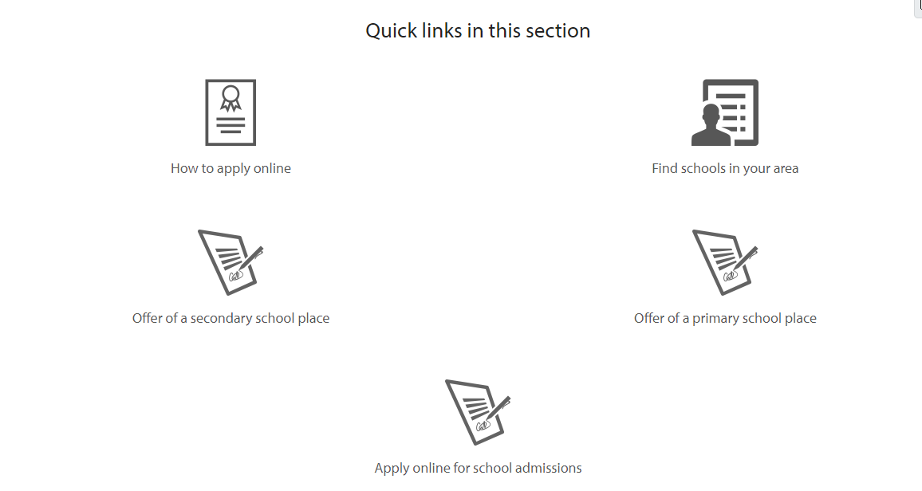
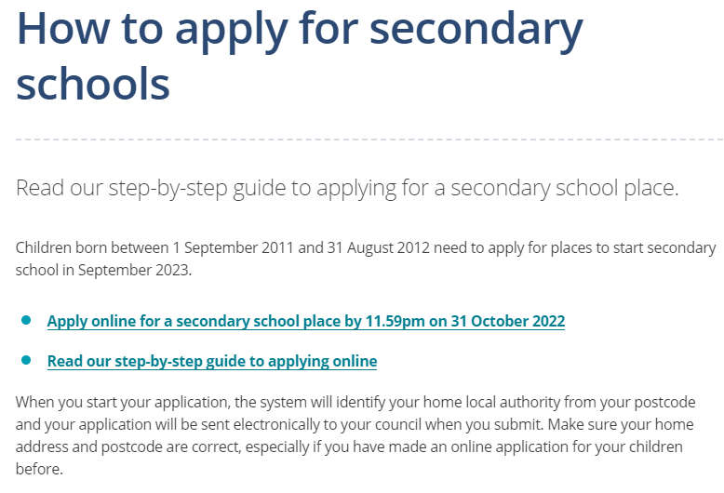
Southwark
Lewisham

Slide 20
To set up an account
You will need an email address – google mail preferable
You will need to set up an account on eadmissions

Slide 21
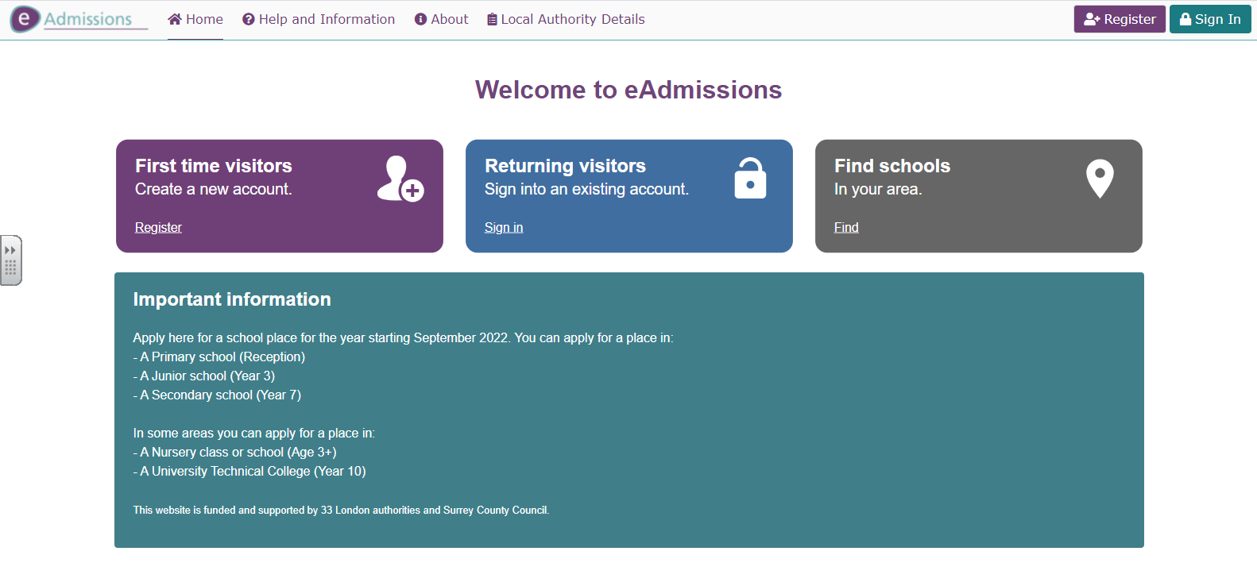
https://www.eadmissions.org.uk/

Slide 22
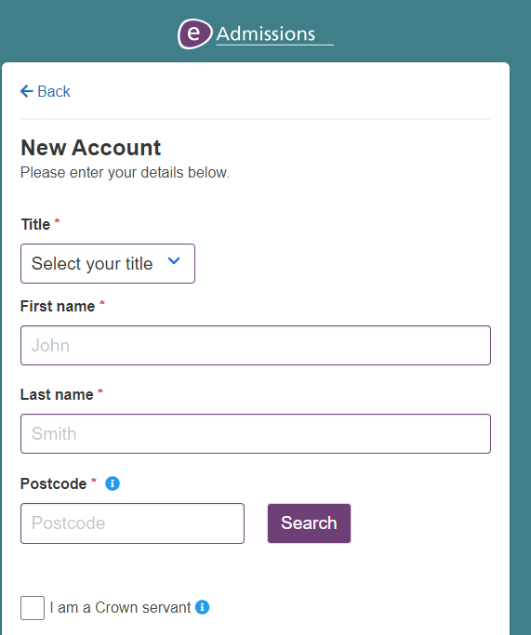
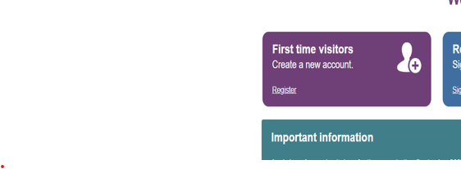

Slide 23
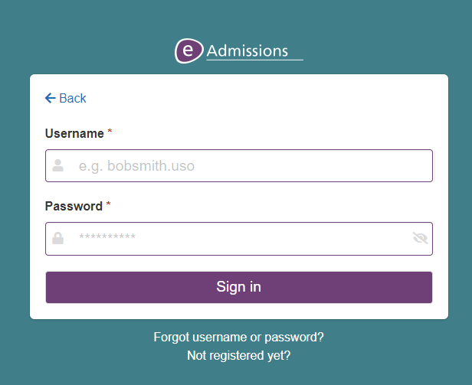
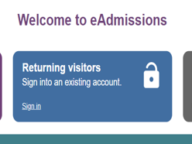
If you already have an account, login will be required so keep your username and password safe
‘Forgotten your user
name or password?’ link and follow the
instructions. Your password can be re-sent to you
by text message or to the email address you used
when you first

Slide 24
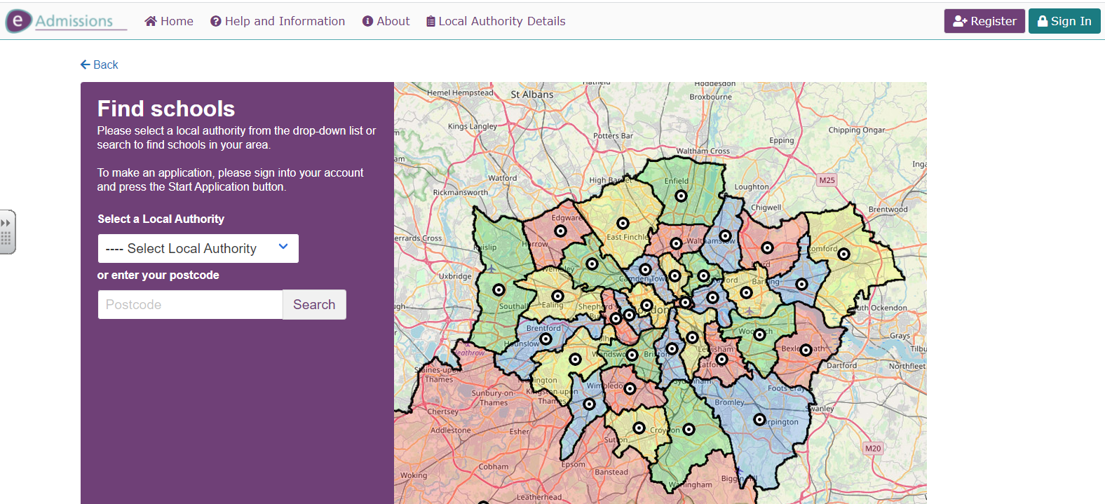
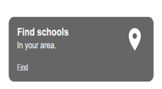
Find Schools using eAdmissions

Slide 25
Preferences
You are given the opportunity to express up to 6 preferences for your child’s school placement.
Make sure that your child meets the schools entrance requirements.
Your child may not get your first choice so make sure you do include other preferences.
You can select 6 schools whether they are in Southwark or within a different borough.

Slide 26
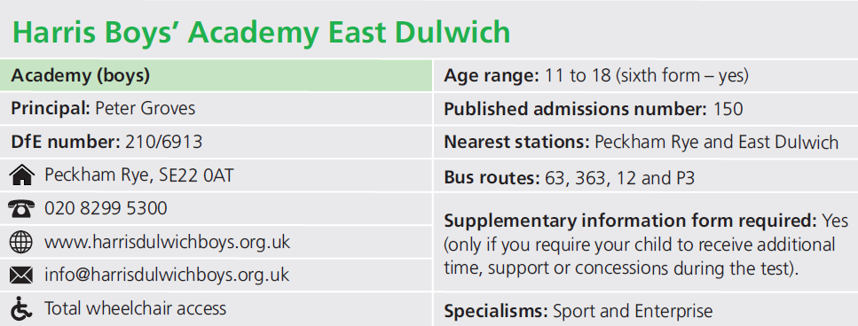
Supplementary Information Form
Referred to as the SIF
You must complete a supplementary information form (SIF) if the school you have listed as one of your preferences requires this.
It will appear on the ‘Schools detail’ page if the school requires one.

Slide 27
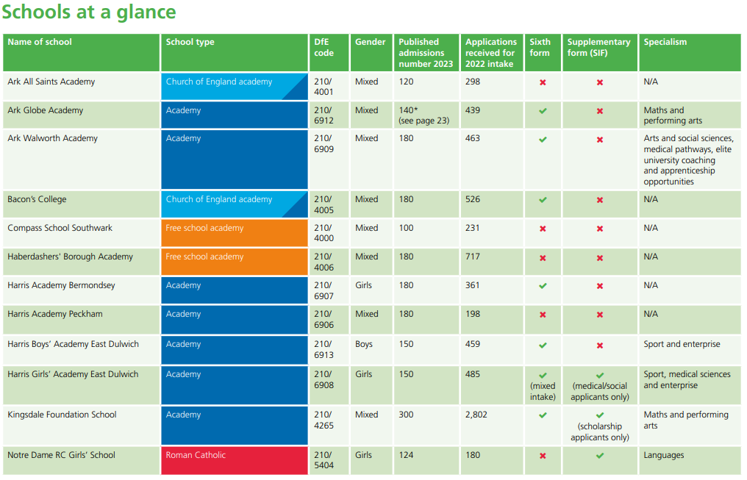
SIF
Specialism

Slide 28
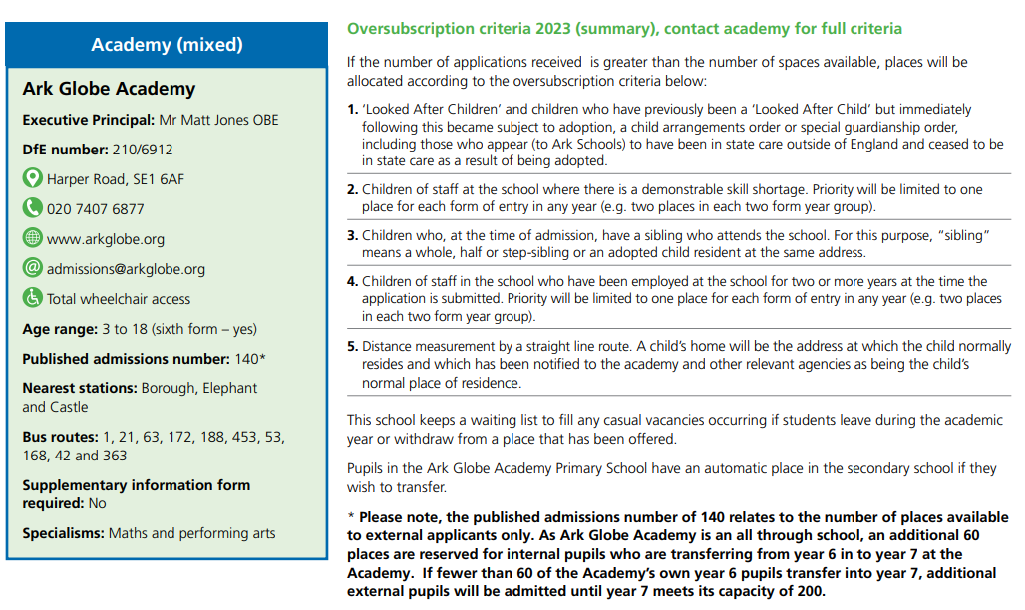

Slide 29
Oversubscription Criteria
If you are applying to a secondary school that uses banding as part of its oversubscription criteria, your child will be required to take a test. Please contact the school for further information. E.g. Bacons

Slide 30
Medical/Social Reason
If you have ticked the ‘social/medical’ box,
you must provide additional information to
support your application such as a recent
medical/social report or letter from a professional.
(This will need to be uploaded.)
You must ensure that you click ‘Next’ each time
you complete a page of the application or your
information will not be saved

Slide 31
Southwark
If your child has a sibling (brother or sister), at one of your preferential schools, please ensure that you tick the sibling box.
Once you have completed your online application, take note that you receive your 16 digit application reference number starting with 210 similar to this: 210-2018-09-E-002100.
If you do not receive a unique reference number it means your application has not been received and you will need to resubmit your application.
Keep a record of your unique user name, password and application number which you will use for your application. It is important to keep this information safe so that you can log in and look at your application and review the results

Slide 32
Late applications
If you are making a late application between 1 November 2022 and 17 August 2023, you must complete and submit an online application at www.eadmissions.org.uk
All late applications received after 31 October 2022 (except those regarded as exceptional circumstance) will not be considered for a school place until after the initial offer of places on 1 March 2023.

Slide 33
Late applications after August 22
If you are making a late application after 17 August 2023, you must complete a separate form as the online application system will no longer be available.
You can request the form from the school admissions team by email at schools.admissions@southwark.gov.uk

Slide 34
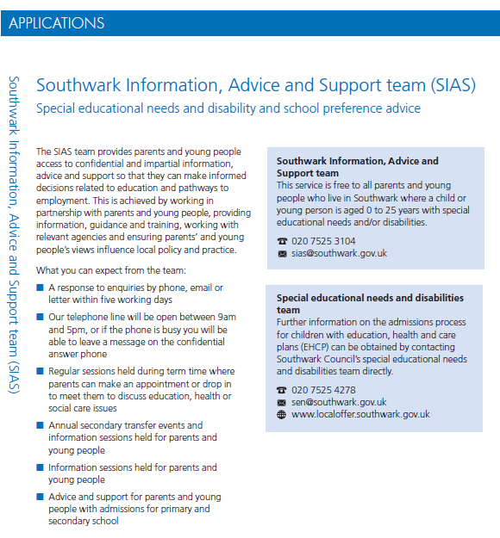

Slide 35
Southwark Admissions
School admissions team 4th floor,
Hub 2 Children’s and adults services Southwark Council
PO Box 64529
London SE1P 5LX
www.southwark.gov.uk/schooladmissions
Email: schools.admissions@southwark.gov.uk
Phone: 020 7525 5337

Slide 36
Lewisham Admissions
Admissions Team
3rd Floor Laurence House 1 Catford Road London SE6 4RU Phone: 020 8314 8282 Email: schooladmissions@lewisham.gov.uk

Slide 37
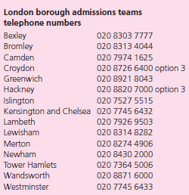

Slide 38
Online Application Support
If you require further support with your application, please contact the school office to make an appointment and we will endeavour to help you in any way we can.

