Slide 1
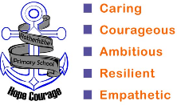
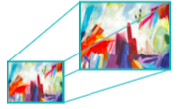
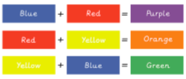
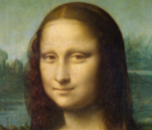
Vocabulary
Year 5 Art and design skills
Key Facts
To scale up means to enlarge.
Complementary colours are opposites on the colour wheel.
Mixing secondary colours from primary colours.
Analytical observational drawing | Drawing real objects from observation, rather than copying from a secondary source, such as a picture.
Annotation | A comment added to a text, book, drawing, as an explanation.
Collage | A work of art made by gluing pieces of different materials to a flat surface.
Computer aided design | A design which has been created using a computer.
Continuous line drawing | A drawing which is made from one long line, without taking the pencil off the page.
Diagram | A drawing that shows the structure or workings of something.
Exploded diagrams | A drawing, that shows all parts of the assembly and how they fit together.
Invention | Something new that someone has designed and made.
Portrait | A painting, drawing, or photograph of a person's head and shoulders.
Prototypes | An original model.
Sketch | A fast, light drawing which is often a plan for a final piece of artwork.
Texture | The way something feels.
Artists’ work looked at:
Leonardo de Vinci An Italian artist. He was an inventor, painter, sculptor and architect and he was inspired by science, music, maths and literature. | Paul Klee Born in Switzerland, he was interested in the theory of colour.
Key questions:
What makes a good invention? Why? What words best describe the textures you can see? What words best describe the shapes you can see? What words best describe the lines you can see? How can we draw things more successfully, especially if we aren’t confident about drawing?

Slide 2
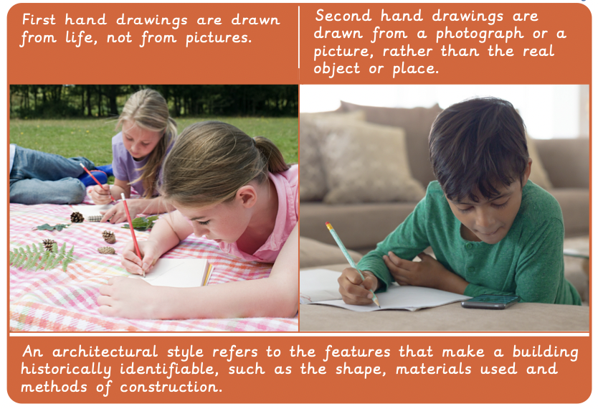
Vocabulary
Year 5 Architecture
Key Facts
abstract | Art which does not represent images of our everyday world. It has colour, lines and shapes but is not intended to represent objects or living things.
amphitheatre | An oval or circular building with rising tiers of seats arranged about an open space.
ancient | Very old.
architects | Designers of buildings.
composition | The placement or arrangement of the different elements, or ‘things’ within a work of art.
cryptic | Something that has a secret or hidden meaning.
legacy | Something that exists as a result of things that happened in the past.
mono print | A form of printmaking where the design or drawing can only be made once.
ornate | Excessively decorated.
pattern | A repeated decorative design.
plaque | A sign that is usually fixed to a wall in memory of a person or event.
representation | Something that is created to look like a particular thing or person.
shading | Creating areas of light and dark, often used to give a 3D effect.
sketch | A light, fast drawing, sometimes created to prepare for later work.
stadium | A building for sports events with space for spectators.
symbolism | The use of symbols to express or represent ideas.
temple | A building that people visit to worship gods or for other religious reasons.
Artists’ work looked at:
Key questions:
Is the building design suitable for a wide range of people? Are local people who see this building likely to approve of it? Have both the interior and exterior of the building been considered? Are the materials used practical, safe and cost effective?

