Slide 1
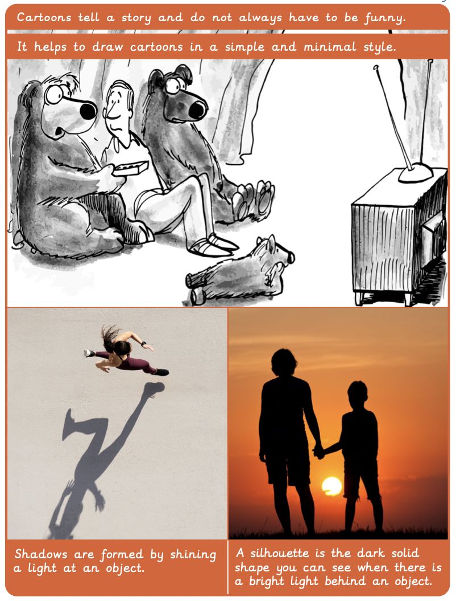
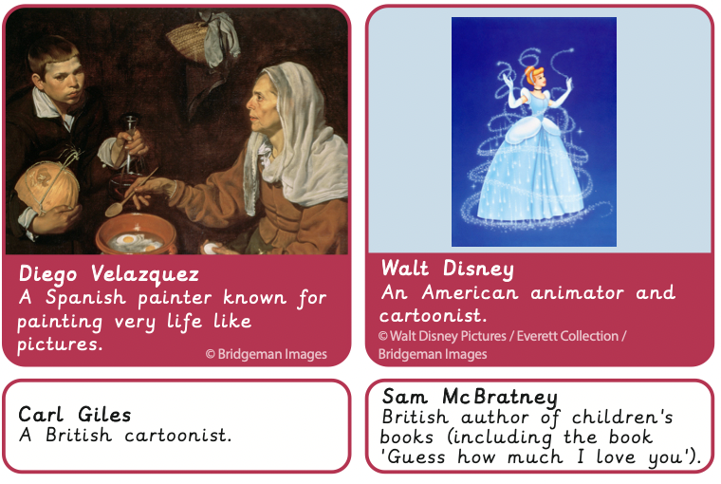
Vocabulary
Year 3 Formal elements of Art
Key Facts
cartoonist | An artist who makes a series of drawings or illustrations.
character | A description of a person.
minimal | A very simple design without many colours.
opaque | A solid surface which you cannot see through.
puppet | A doll moved by your hand or strings.
sketching | A fast, light drawing which is often made as a plan for a drawing or painting.
style | The way in which something has been drawn.
three dimensional | A solid object, with height, length and width.
tint | The adding of white to make a colour lighter.
tone | The lightness and darkness of a colour.
Artists’ work looked at:
Key questions:
Was it easier to see the shapes of natural or man-made objects? Where it is more difficult to see a shape in an object, can we use more than one shape and combine them? Do you think drawing simple shapes first helped you create your drawing?

