Slide 1
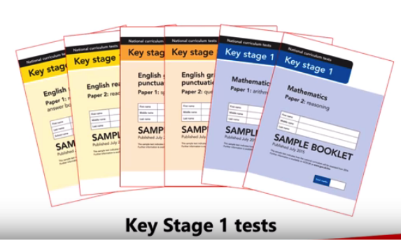
KS1 SATs
Information for Parents
Rotherhithe Primary School

Slide 2
When are the tests?
KS1 tests must take place in May.
Each school can choose their own assessment timetable. We carefully spread the tests out across 3 weeks.
We aim to administer the tests in small groups away from the rest of the class to ensure it is as stress-free as possible. Pupils can take breaks if needed.

Slide 3
Which Subjects?
Reading Test
Paper 1 and Paper 2
(Writing is teacher assessed)
Mathematics Test
Arithmetic test and Reasoning test
Spelling, Punctuation and Grammar
Spelling and Grammar

Slide 4
Mathematics

Slide 5
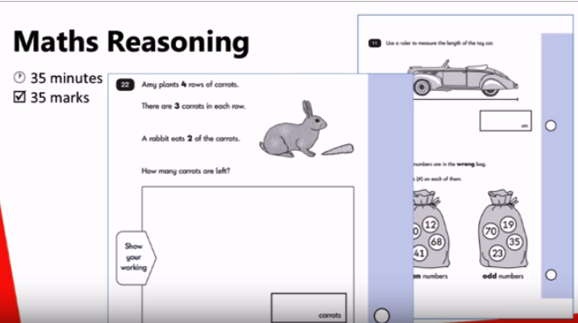
Mathematics

Slide 6
Reading

Slide 7
Reading

Slide 8
SPaG

Slide 9
SPaG

Slide 10
SPaG

Slide 11
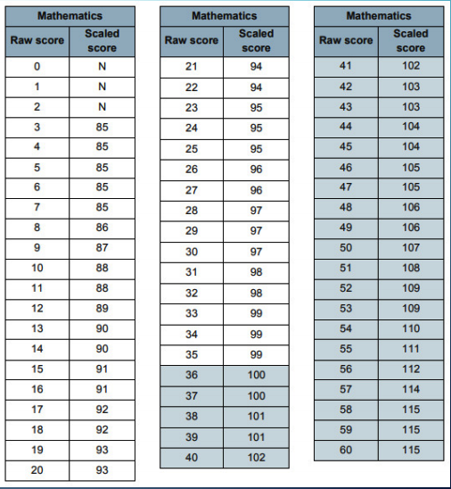
Scaled Score
Notes:
The results of the two papers are added to give a raw score. We then use a conversion chart which gives us a scaled score. This pass mark changes each year

Slide 12
KS1 SATS 2019
Grades:
Working Towards (below)
Expected
Greater Depth (above)
Subjects:
English (reading & writing), Maths (arithmetic and reasoning) and Science

Slide 13
The Interim Framework
Please look at the examples provided:
Additional info:
www.gov.uk/STA
Notes:
Your child’s teacher will consider lots of different forms of evidence (book work, tests, observations etc) to determine their final grade.
The assessment criteria for working towards, expected and greater depth is set out in the Interim Framework. In KS1 teacher’s use the tests to support their final judgments.

Slide 14
What if my child has additional needs?
We can make special arrangements:
Additional time
A scribe
A reader

Slide 15
Early nights and plenty of rest

