Slide 1
Notes:
Teacher notes:
Display this slide as the children come into the hall for assembly.

Slide 2
Notes:
Teacher notes:
On Friday 14th October/ next week/ on Friday we are going to take part in Big Me day. We are all going to have the chance to be Big Me for the day and come to school dressed up as what we want to be when we grow up.

Slide 3
Notes:
Teacher notes:
Lots of schools all over the country will be taking part in Big Me. And we will all be raising money for a charity called ActionAid. ActionAid helps children all over the world like Joshua, Israa, Pascale and Farness. Let’s do a quick quiz to find out more about ActionAid.
Q: How many people in the world don’t have enough to eat?
A: 795 million people, or 1 in 8 (you can demonstrate this by asking 8 children to stand up and demonstrating what 1 in 8 looks like).
Q. How many children in the world are missing out on school?
A. 58 million children, or 1 in 10 (you can demonstrate this by asking 10 children to stand up and show what 1 in 10 looks like).
Q. How does ActionAid help children you don’t have enough food, or don’t go to school?
A. ActionAid helps children to go to school by making sure schools have enough teachers, desks, pens and pencils. ActionAid makes sure children to have enough to eat by helping their families to learn to grow vegetables, farm animals and catch fish.

Slide 4
Notes:
Teacher notes:
Watch the video here: https://youtu.be/iX0zZ6ydzs0 or by clicking on the slide when the slide show is playing in full screen.
Before video:
Let’s meet some of the children that ActionAid works with. I want you to listen carefully and see if you can find out what the girls in this video want to be when they grow up.
After video:
Q. What did the girls in Bangladesh want to be when they grow up?
A. Pilot, painter, doctor
Q. How was ActionAid helping the girls in the video?
A. Helping them find somewhere to live and go to school. Helping them to have enough food to eat.

Slide 5
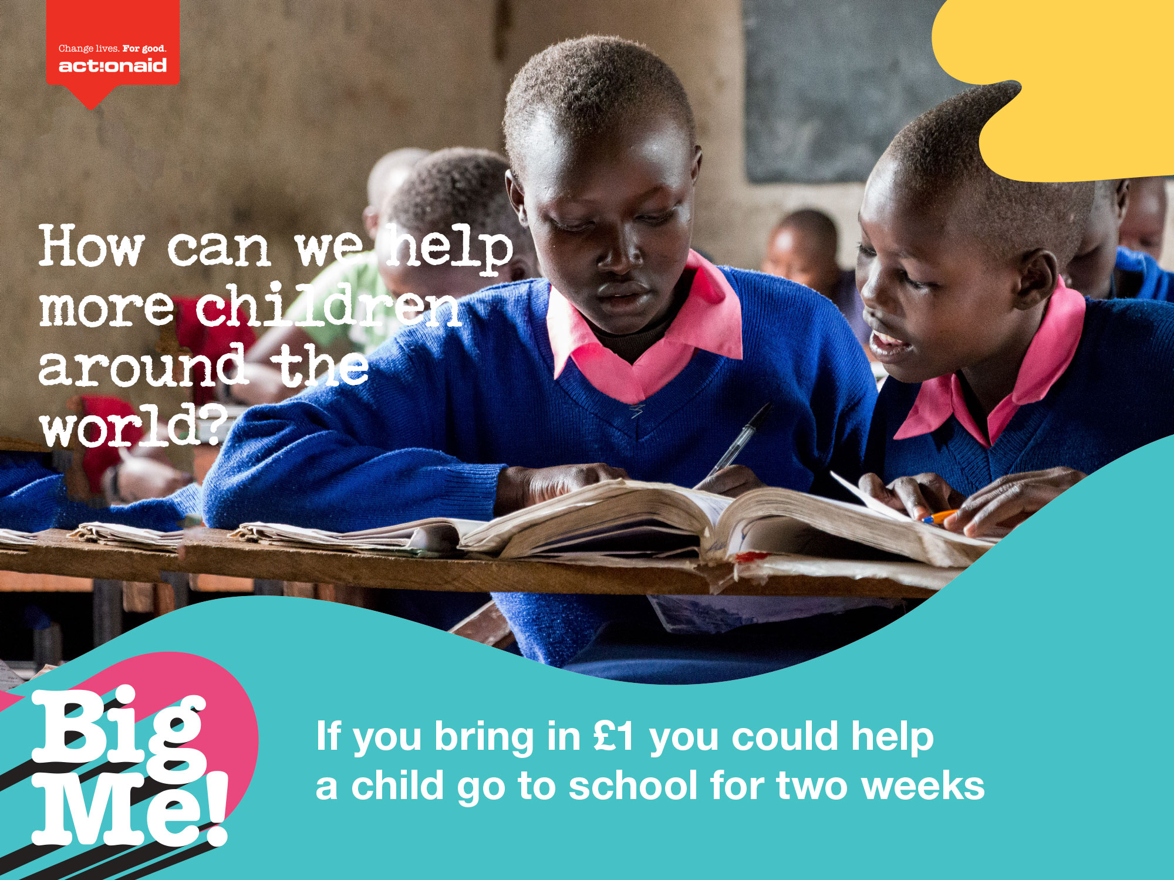
Notes:
Teacher notes:
On Big Me day we will all bring in a small donation for ActionAid. Let’s see how our donations will make a difference.
If you bring in £1 on Big Me day you could help a child go to school for two weeks.

Slide 6
Notes:
Teacher notes:
Lots of children around the world don’t have anything to play with. Some children have had to leave their homes because of war in their country, and leave all of their things behind. £20 raised from one class on Big Me day could help buy toys for this children, so they can play just like you.

Slide 7
Notes:
Teacher notes:
And now let’s see how all of our donations added together will help to change lives. If our whole school raises £300 we could support a happy home like the one we just saw in the video of Sonia.

Slide 8
Notes:
Teacher notes:
Who has heard of the book “The Fearsome Beastie”? Or “Tamara Small and the Monster’s Ball”?. Well, the author of that book, Giles Paley-Phillips, is a supporter of ActionAid. All of the schools who raise money for ActionAid on their Big Me day will be entered into a prize draw and the winner will win a visit from Giles. He will read his brand new book and he will talk about what he wanted to be when he was younger, and how he became an author!
Giles says: *Read quote from slide*

Slide 9
Notes:
Teacher notes (Optional slide – only use if you are planning to do other things on your Big me day to raise money)
There are lots of things we could do to raise money for ActionAid. Who has an idea about what they could do? Who thinks they could organise a bake sale on Big Me day?

Slide 10
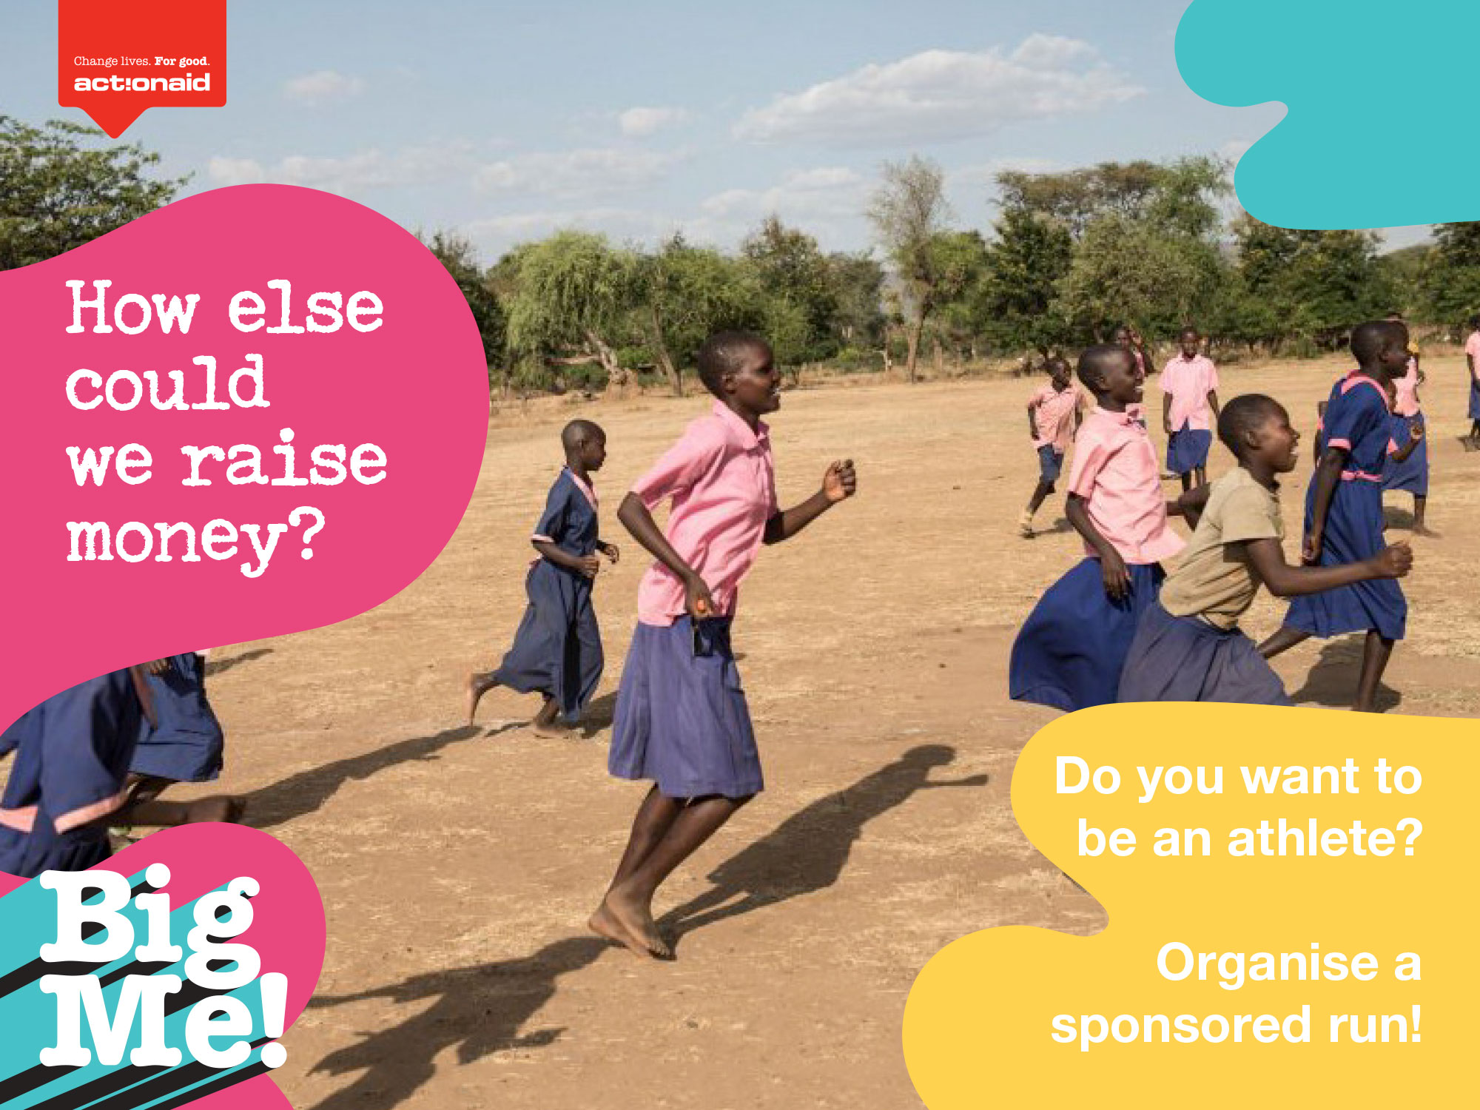
Notes:
Teacher notes (Optional slide – only use if you are planning to do other things on your Big me day to raise money)
Who thinks they could organise a sponsored run on Big Me day?

Slide 11
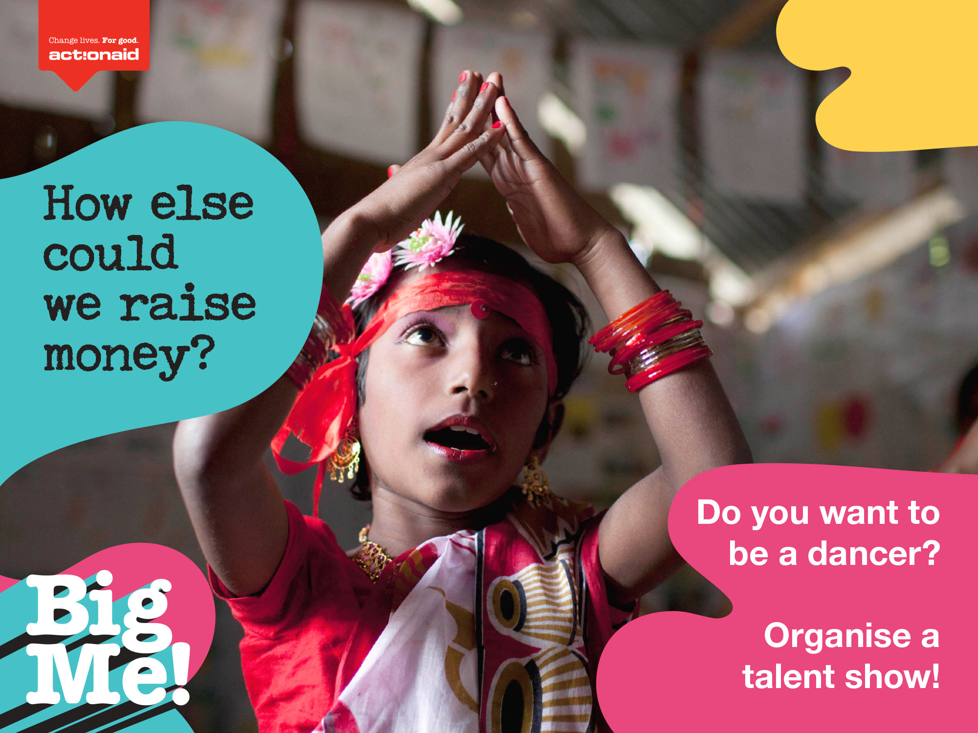
Notes:
Teacher notes (Optional slide – only use if you are planning to do other things on your Big me day to raise money)
Who thinks they could organise a talent show on Big Me day?

Slide 12
Notes:
Teacher notes:
This is a blank slide for you to add any extra information

Slide 13
Notes:
Teacher notes:
So don’t forget that Big Me day is on Friday 14th October/next week/ on Friday. There will be lots of fun activities for us to do on the day. You will all be given a letter to take home to parents or guardians tonight so you can start thinking about what you will dress up as!

