Slide 1

Read Write Inc Phonics Parent Workshop
Aims:
To provide an overview of the Read Write Inc. phonics programme.
To introduce the key sounds that children are currently being taught.
Share phonics screening check materials.
Explain how children are tested.
Consider how parents can support at home.
Answer any questions.

Slide 2
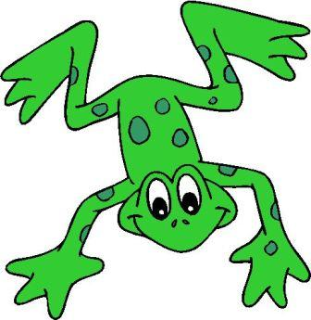
Synthetic Phonics
Read Write Inc is a synthetic phonics programme that is used in school. Research has shown that synthetic phonics is the best method/tool to teach young children to read.

Slide 3
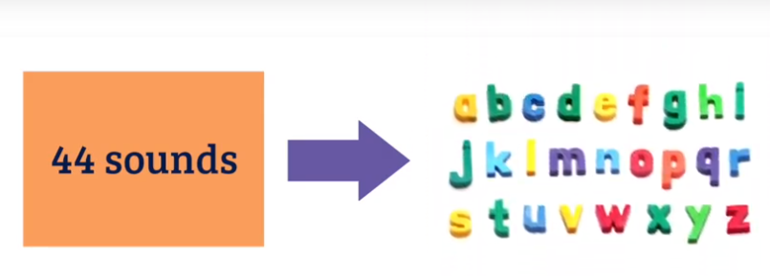
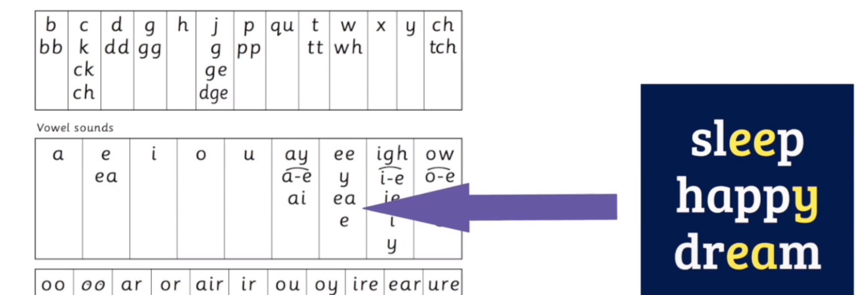

Slide 4
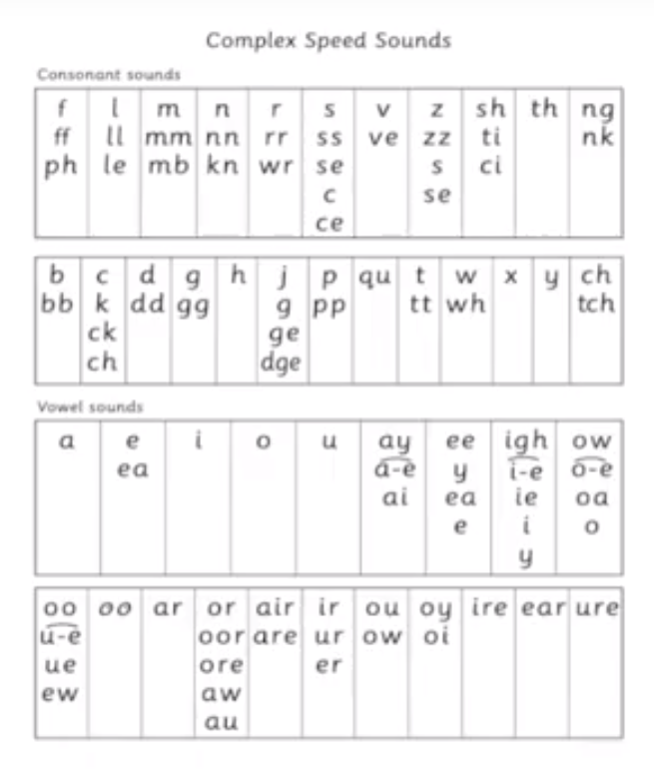
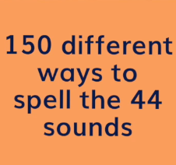

Slide 5
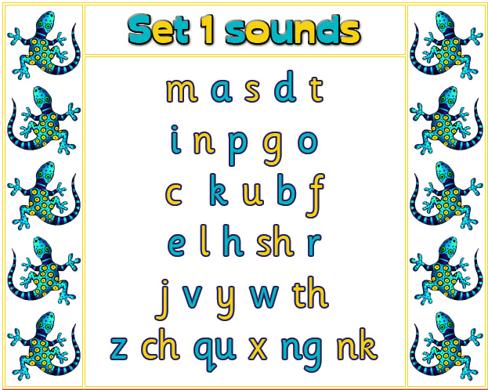
Set 1, 2 or 3 Speed Sounds
The children are taught to read sets of speed sounds. Set 1 sounds are taught first and in the following order. They are taught to read these quickly.

Slide 6

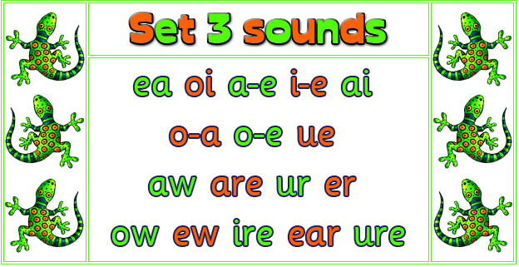
Set 2 & 3 Speed Sounds
When the children are confident with Set 1 sounds, set 2 sounds are taught and then finally set 3 sounds.
These sounds are called digraph or trigraph, because 2 or more letters represent 1 sound.

Slide 7
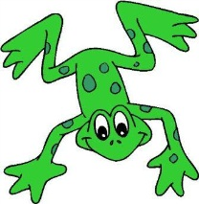
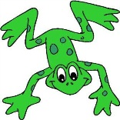


To help children to remember the speed sounds a
mnemonic picture card and rhyme is used. For set 1
sounds this is linked to teaching children
how to write letters accurately.
For set 2 and 3 sounds this is to help
the children to remember the digraph (when 2 letters make one sound) or trigraph (3 letters make 1 sound)
e.g; for ‘ow’ the rhyme
‘blow the snow’
is taught.

Slide 8
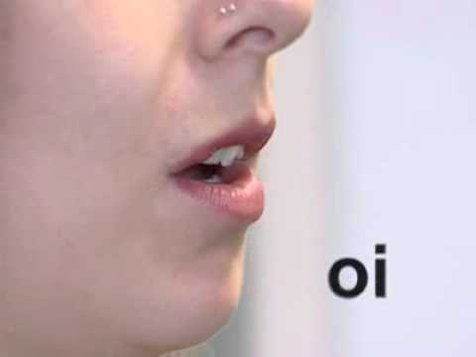
How to pronounce speed sounds
It is really important that the sounds are pronounced clearly. You may hear this referred to as using ‘pure sounds’.
Watch the following you tube link:
http://www.youtube.com/watch?v=BqhXUW_v-1s

Slide 9
Split ‘e’ words
Sometimes referred to as: silent ‘e’/ mute ‘e’/ magic ‘e’ it’s technical name is split digraph.
The children are taught to recognise this as 1 special sound. The ‘e’ does not make a separate sound at the end of the word but has changed the first vowel sound.
E.g. in
win wine man mane tune
We call digraphs special friends with the children and encourage them to look for these before reading words.

Slide 10

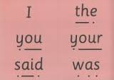
Blending/Green Cards/Red Cards
As the children are taught to blend they are presented with words to read. These are called ‘Green Words’, (words that they are able to use phonics to help them read). They have sound buttons (dots) to help
cue them in.
Words that are tricky and that they cannot ‘Fred Talk’ are taught on red cards and are called ‘Red Words’.

Slide 11

Blending
Practise making words using the cards.

Slide 12

Fred Fingers
We teach the children to spell out words using their fingers to help them. They put out fingers for the number of sounds they can hear not the number of letters in a word.
We refer to this as ‘Fred Fingers’.
Notes:
We use Fred Fingers to help children sound out words to spell easily. This is a tool that helps them spell any word. It means children do not have to memorise lots of words before they can try writing.
Demonstrate how to use Fred Fingers with a simple word like cat. Ask parents to hold up three fingers and show how the children say cat and pinch the sounds and write them down.

Slide 13
Year 1 Phonics test
Occurs in June – will be held the week of the 12th
All children are tested by their teacher
32 is usually the pass mark
Includes real and nonsense words
Only tests children’s ability to read words in isolation

Slide 14
Access Arrangements
The teacher will ensure that the children's mental health is high.
If a child finds it hard to sustain concentration or needs a break then it will be given. The test has to be completed on the same day that it is started.
Children may be permitted to draw sound buttons under words if this supports their understanding

Slide 15
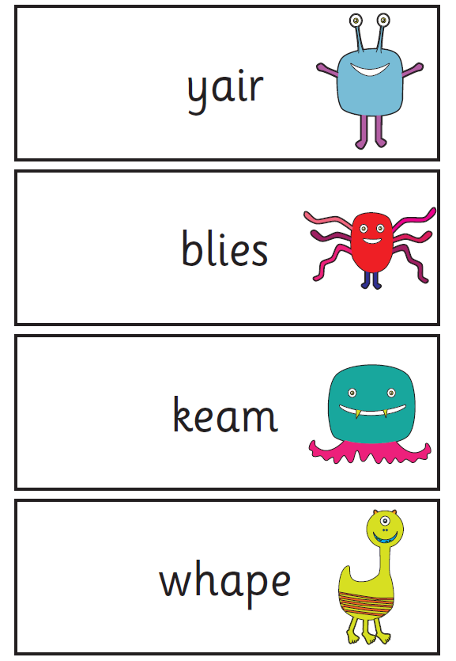
Nonsense words/Alien words
Deliberately included to check children’s ability to use phonic skills.
Half the test consists of nonsense words

Slide 16
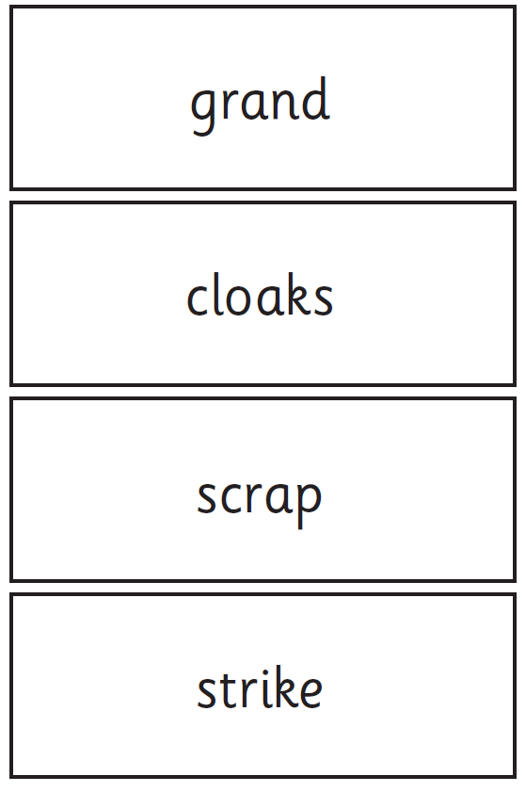
Real words
These can contain any combination of phoneme sounds taught.
Children must blend sounds accurately to be awarded a mark.
Notes:
https://www.youtube.com/watch?v=IPJ_ZEBh1Bk

Slide 17

Training video
https://www.youtube.com/watch?v=IPJ_ZEBh1Bk&ab_channel=DepartmentforEducation
Notes:
https://www.youtube.com/watch?v=IPJ_ZEBh1Bk&ab_channel=DepartmentforEducation

Slide 18
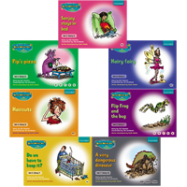
Home School Reading
You should receive a RWI phonics text book at some point each week. It is really important that you read through these books with your child.
The vocabulary in these books is controlled to make sure your child can decode most words that they meet. They are designed to reinforce previous learning.
Please make sure that your child looks after these books.

Slide 20
Short 60 seconds of practicing sounds

Slide 21
To help children remember red words encourage them to take a photograph of the word in their mind, encourage them to practice writing the word and make the word using cards or magnetic letters.
Notes:
http://www.ruthmiskin.com/en/resources/parent-tutorial-storybook-activities-green-and-red-words/

Slide 22
Do discuss key vocabulary and the meaning of words with your child.

Slide 23
Text Reading
You can see that ‘Red Words’ are written in red. If your child struggles to read a ‘Red Word’ tell them what it is. If is a word in black then encourage them to ‘Fred Talk’ the word (sound it out).
If they still struggle then give them the word.
Don’t forget to praise them for trying and what they get right.
Notes:
https://www.youtube.com/watch?v=6QVfbYvPaAM

Slide 24
Do talk about the books children read. RWI books provide questions that you can ask about. Let children check in the book for answers. Don't treat this as a memory test.

Slide 25
For quick practice

Slide 26

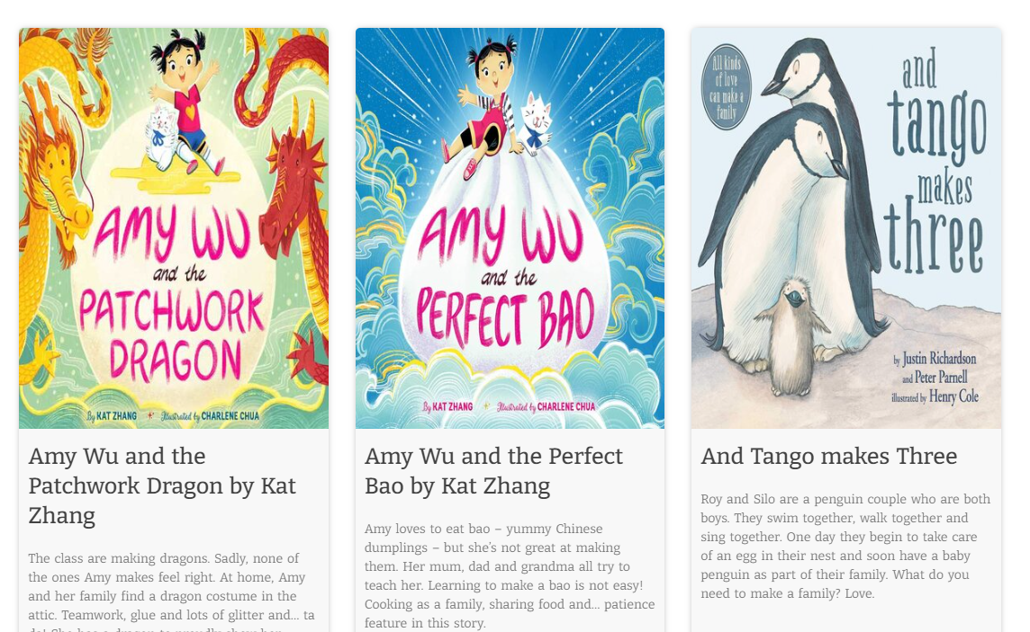
Read lots of stories to your child
Reading books to your child and talking about books helps them to build vocabulary a key predictor of success with reading.
Notes:
Read stories with your child as often as you can – this will make the biggest difference to their language development.
Read their favourite stories many times, children love hearing the same story again and again. Encourage your child to join in with the story.
Let them tell you the story using the pictures.
We will run workshops on storytelling and send books home for you to share. Add any details here as appropriate e.g. when the first workshop will take place or whether you are running story sessions that are open to parents.

Slide 27

To Finish then…
Any Questions?

