Slide 1
Year 2 Team
Seal Class
Teacher: John Deighan
Teaching Assistants: Anna and Lubanna
Coral Class
Teacher: Alex Montgomery
Teaching Assistants: Lucy and Lubanna

Slide 2
School Day
To ensure social distancing, start and end time have been staggered. this will be reviewed regularly and may have to change.
Year 2 children will arrive at 8:40am and enter through the main office gate. The children will then leave school at 2:55pm through the main office gate.

Slide 3
School Uniform
All children were well dressed in the correct uniform last week ☺
Name all clothes
PE kit – dark shorts/trousers, white t-shirt, sports socks, trainers

Slide 4
Play Time / Lunch Time
In order to minimise contact between children and staff in different year group bubbles, the playground has been divided into different zones.
Children will be required to stay within their year group bubble and within their zone for playtime / lunch time.
Children will wash their hands before and after playtime / lunchtime.
Lunch time have been adjusted to reduce contact between year group bubbles. When eating lunch, children will sit within their year group bubble, leaving the lunch hall as one group.

Slide 5
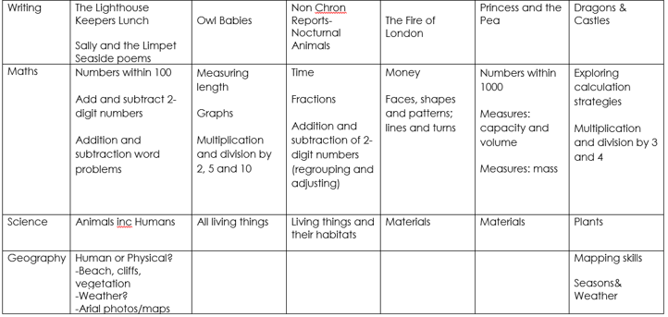

Slide 6
Handwriting
Children are expected to be joining using the cursive style.
There are a few key things to remember:
Start from the bottom of the line and sweep up to form the first letter. Saying ‘up the hill’ will help children remember this!
When joining, do not take the pen or pencil off the page until the whole word is completed! When it is finished, go back and cross and dot where needed.
When the word is finished, flick out the last letter as if you were going to continue joining.
The cursive alphabet
a b c d e f g h i j k l m n o p q r s t u v w x y z
When joined, it looks like this…

Slide 7
Seal Class
Monday | Tuesday | Wednesday | Thursday | Friday
P.E. Kit Books Changed |  | Spelling Test | P.E. Kit | Spelling words Sent

Slide 8
Coral Class
Monday | Tuesday | Wednesday | Thursday | Friday
P.E. Kit Books Changed |  | Spelling Test P.E. Kit |  | Spelling words Sent

Slide 9
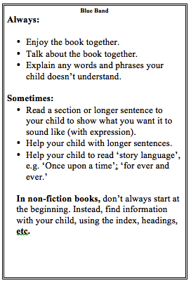
Reading at home daily

Slide 10
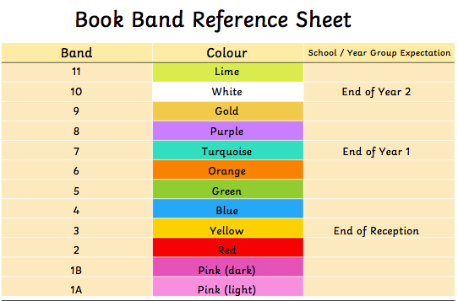

Slide 11
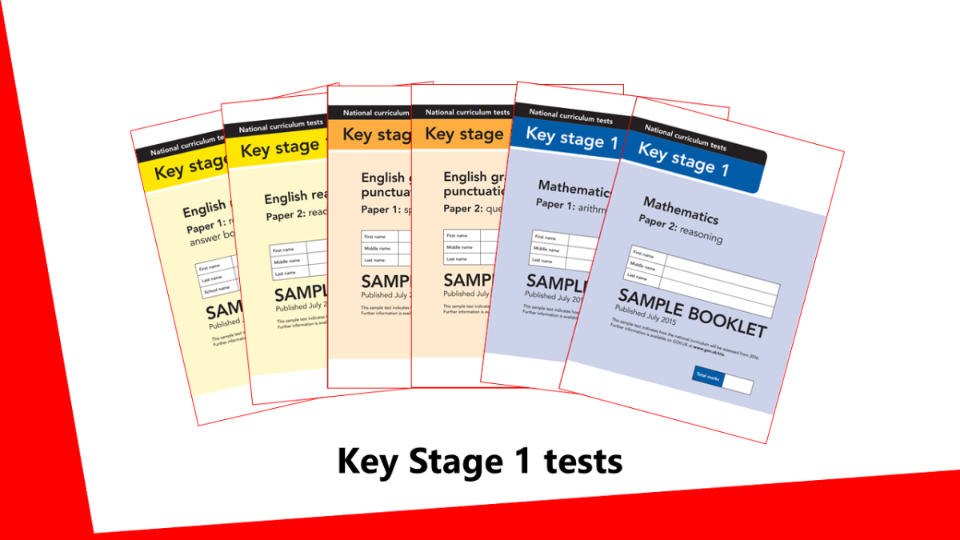
SATs – Summer Term 1

Slide 12
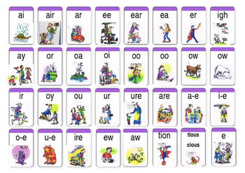

Slide 13
Maths
Within 20 number bonds at speed
2, 5, 10 - tests like spelling tests
Doubles/halves
Money

Slide 14
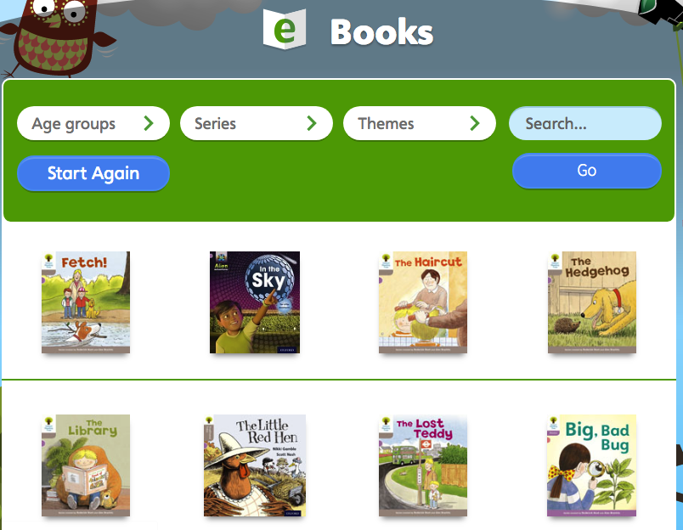
Reading
https://www.oxfordowl.co.uk/
Oxford owl
Book band levels

Slide 15
Rewards and Systems
Star of the week – in class
Sport certificates
Handwriting star
Spelling certificates
Golden Time
Prizes

Slide 17
How you can help at home:
Maths with parents website.
Limit screen time.
Play games.
Ask questions about what your child has learnt
Library
Involve them in day to day life/routines – shopping, cooking.

Slide 18
Communication
Weekly Newsletter
School Website: www.rotherhitheprimary.co.uk
Emails
As face-to-face contacts will be limited, your child’s class teacher may contact you via class email. Any significant injuries will be continue to be communicated by telephone.
Contacting the school office
Office Reception hours will be from 9:30am – 3:00pm, parents and visitors cannot be accommodated in the office outside of these times as this will affect children’s start and leaving times.
On occasions text

Slide 19
Contact Details
Please contact the school office to let us know if you have changed your contact details. It is important that we are able to get in contact with you in the case of an emergency.
Important Details Required:
Landline telephone number
Mobile number (for text messaging service)
Current address
Work number
Next of kin/emergency contact number & address
Email address (for email list)

Slide 20
After School Club and Breakfast Club
Tree Tops Clubs will be offering Breakfast Club and After School Club. All clubs are Ofsted registered and the staff team is carefully recruited following safer recruitment practices. Members of the team are DBS checked, trained in Safeguarding, First Aid, Health and Safety and Behaviour Management, Senior staff hold qualifications in childcare or playwork and regular supervision and CPD is carried out for all our staff.
Bookings can be made directly though their website.
http://www.treetopsclubs.co.uk/listing/dog-kennel-hill-primary-school/

Slide 21
Websites:
https://www.oxfordowl.co.uk
https://www.teachhandwriting.co.uk
https://www.mathswithparents.com
https://www.ttrockstars.com
https://www.topmarks.co.uk/maths-games/hit-the-button
https://www.npc.ie
Thank you for coming ☺

